Slide 1
Opening the decihertz band to GW detection
The Lunar GW Antenna
Jan Harms
Gran Sasso Science Institute
INFN National Labs of Gran Sasso
Lunar Gravitational-wave Antenna, ApJ 910, 1 (2021)
Important update (Dec 2021): Lunar Gravitational-wave Antenna published at
https://www.nationalacademies.org/our-work/decadal-survey-on-life-and-physical-sciences-research-in-space-2023-2032

Slide 2






















LGWA Collaborating Institutions

Slide 3
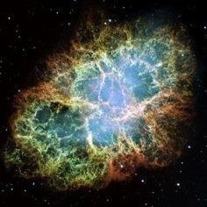
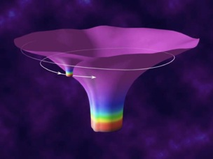
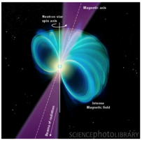
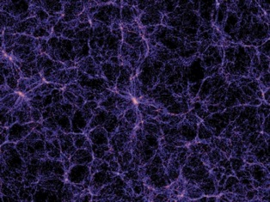
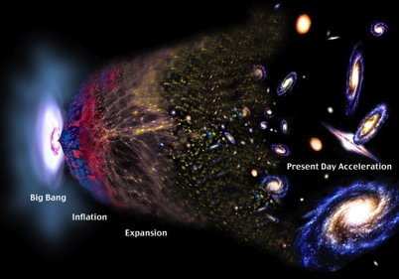
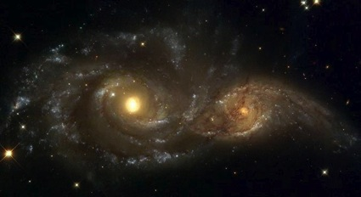
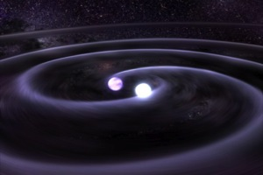
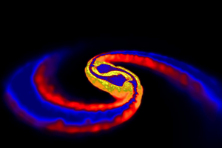
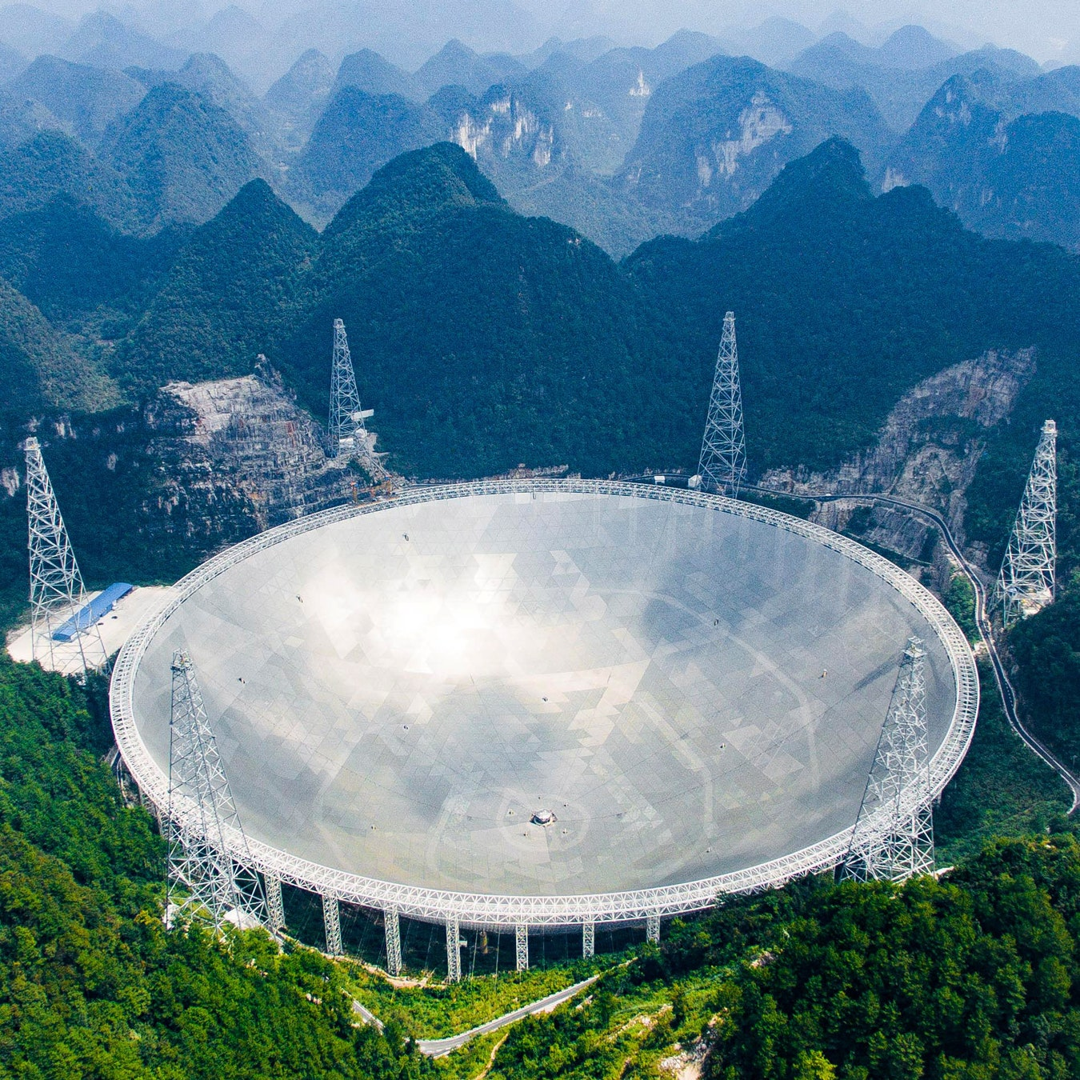
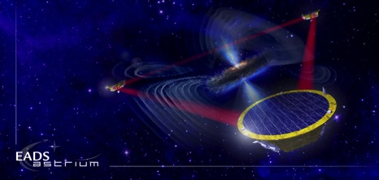

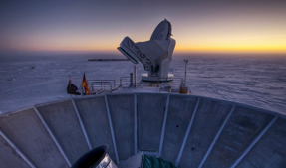
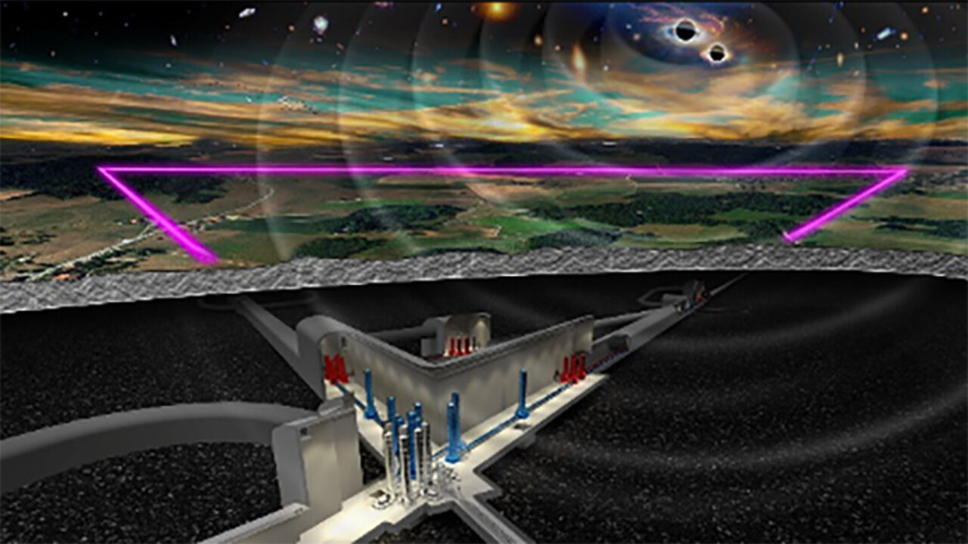
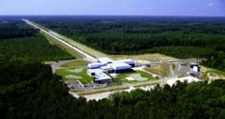
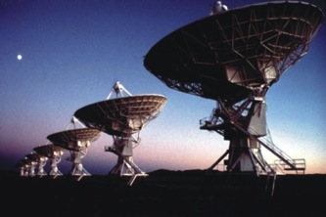
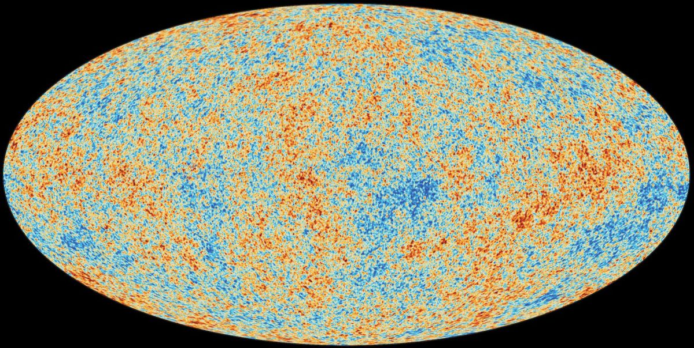
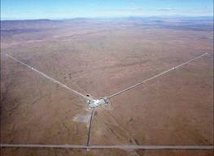
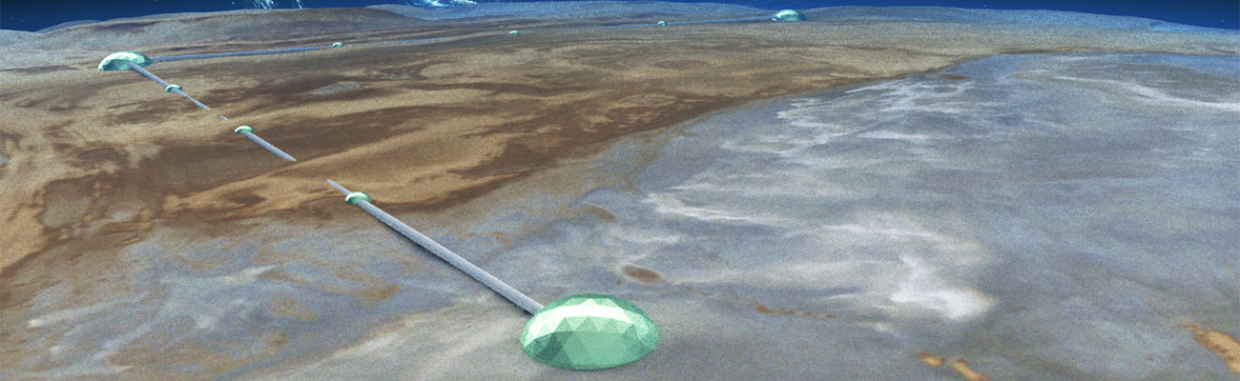
GW Observations
Extreme mass-ratio inspiral
Supernovae
Cosmic strings
Background radiation
Spinning NS
Binaries
BH and NS
Supermassive BH
binaries
Coalescing binaries
10⁻¹⁶ Hz
10⁻⁹ Hz
10⁻⁴ Hz
10⁰ Hz
10³ Hz
Inflation probes
Pulsar timing
Space detectors
Terrestrial

Slide 4
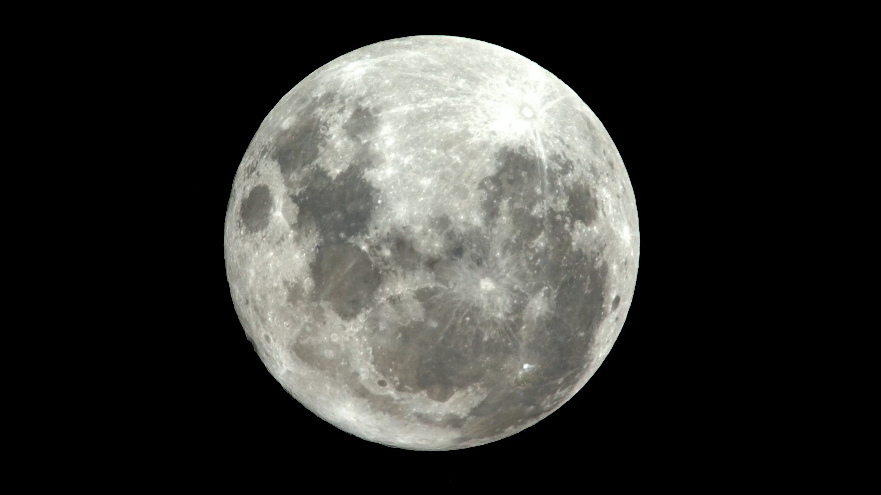
Quadrupolar vibration induced by a GW
(here showing spheroidal mode)
Notes:
Taking the Moon and turning it into a resonant antenna to listen to our Universe would be a huge cultural achievement, and for science, you cannot get closer to science fiction than this.

Slide 5
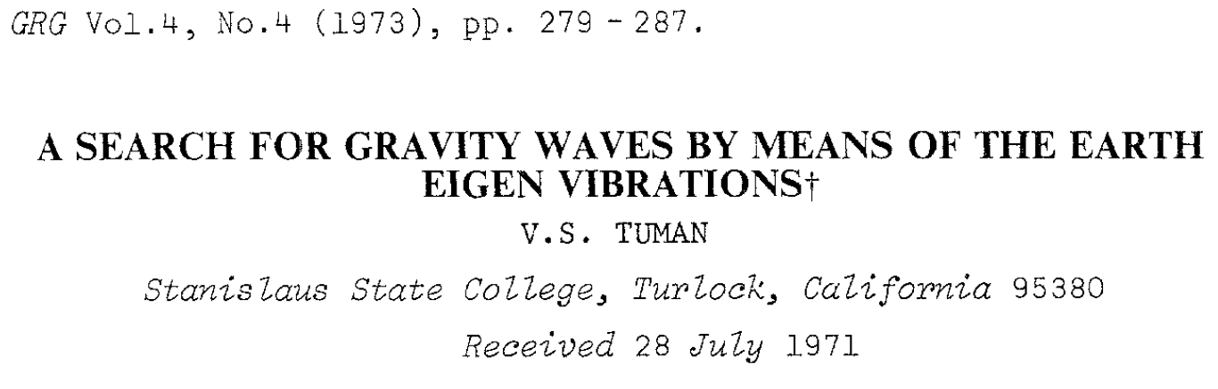
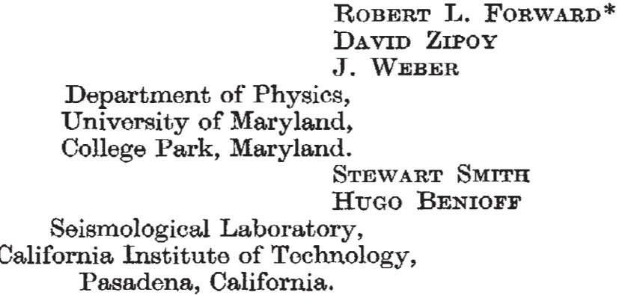
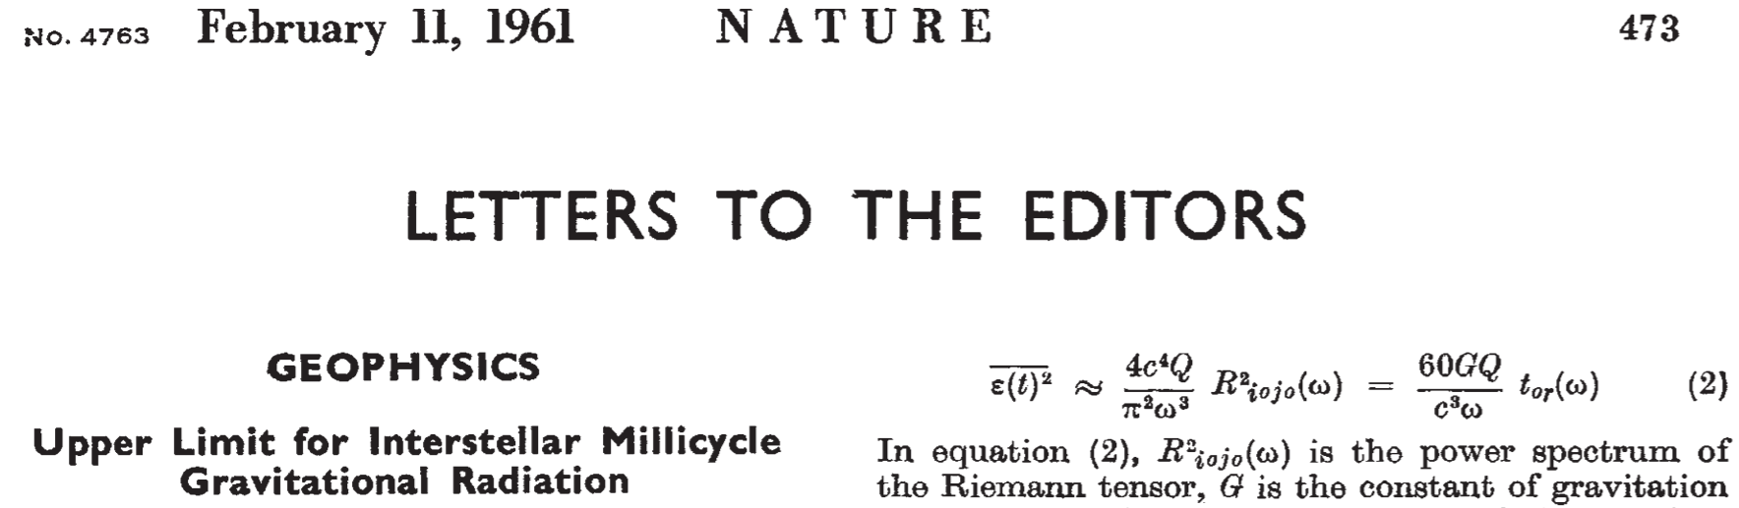
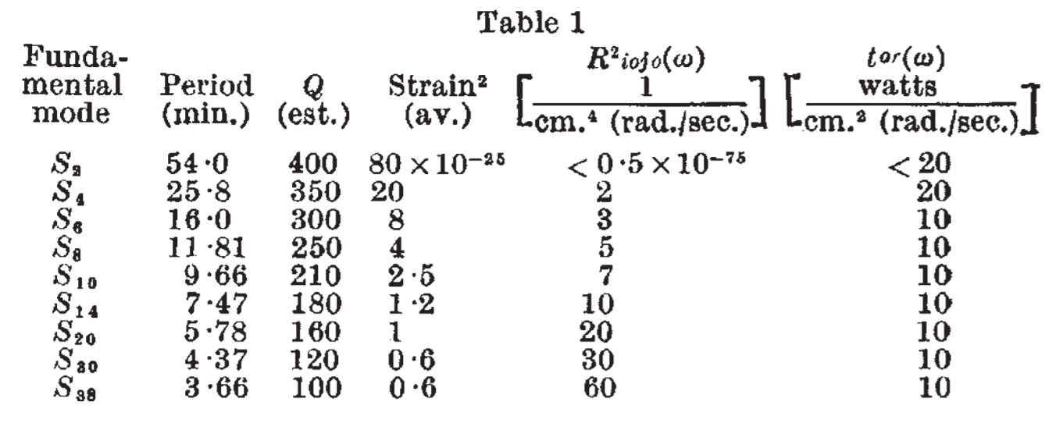
Searches on Earth
Data from N.32°W.
Benioff strain seismograph at Isabella, CA
Upper limits on Riemann-tensor power spectrum
Data from a cryogenic gravity meter (magnetically levitated Nb ball with SQUID readout)
Energy differential of odd and even modes between two sites (100km distance) used to set upper limit on GW energy
Multiply with 8·10⁴⁹·(1mHz/f)⁴ to get GW strain PSD

Slide 6
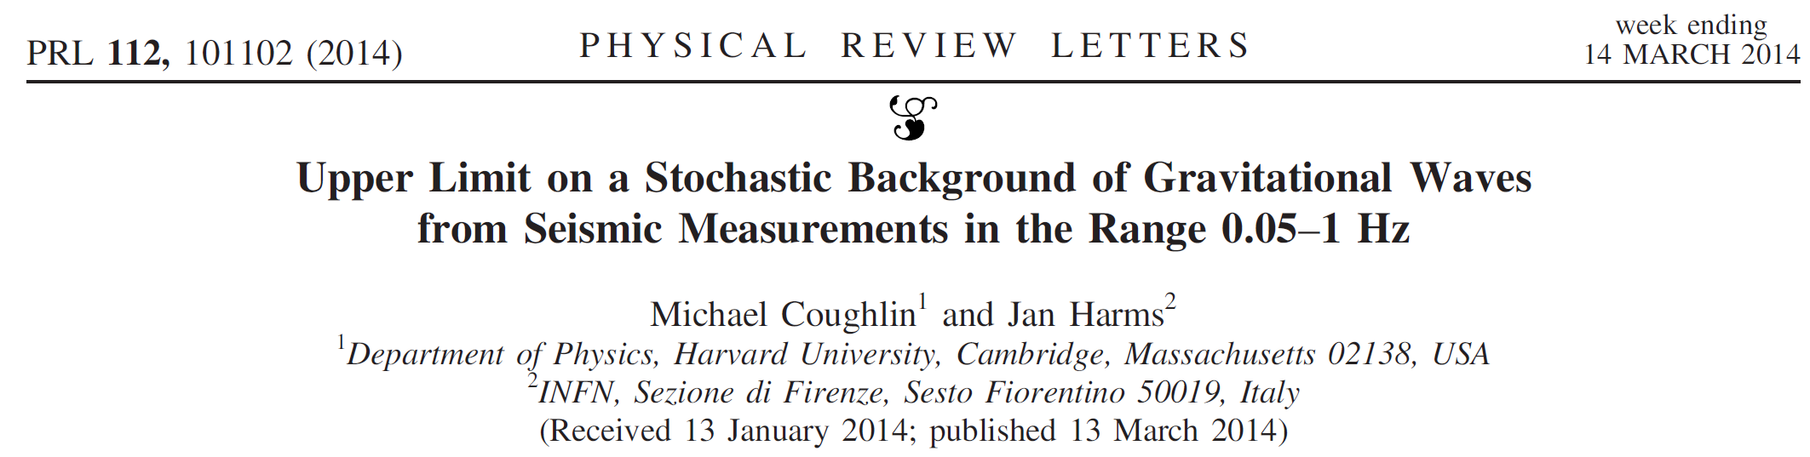
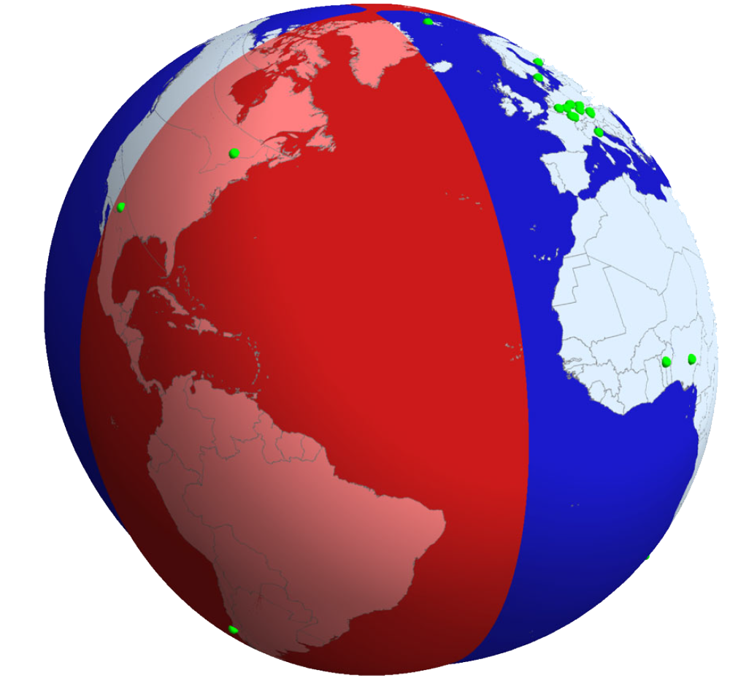
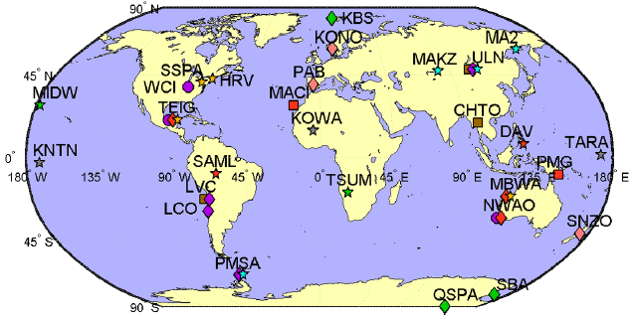
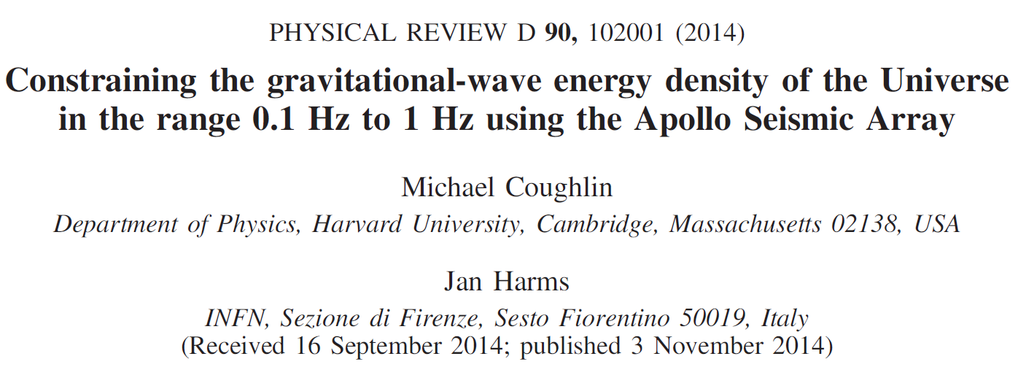
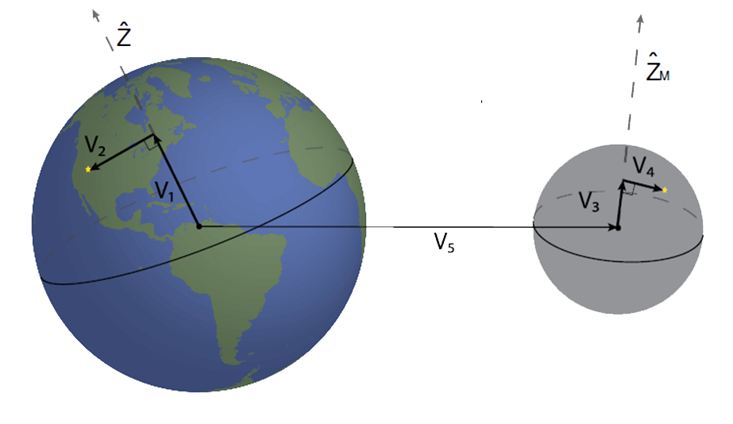
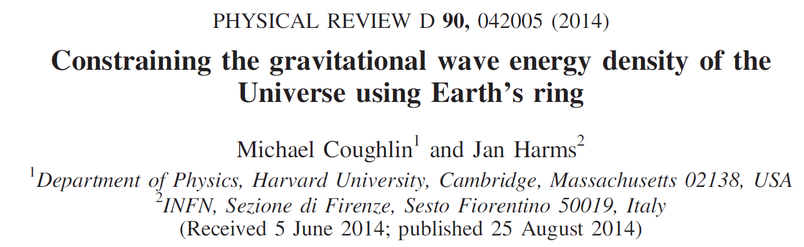
Studies of 2014

Slide 7
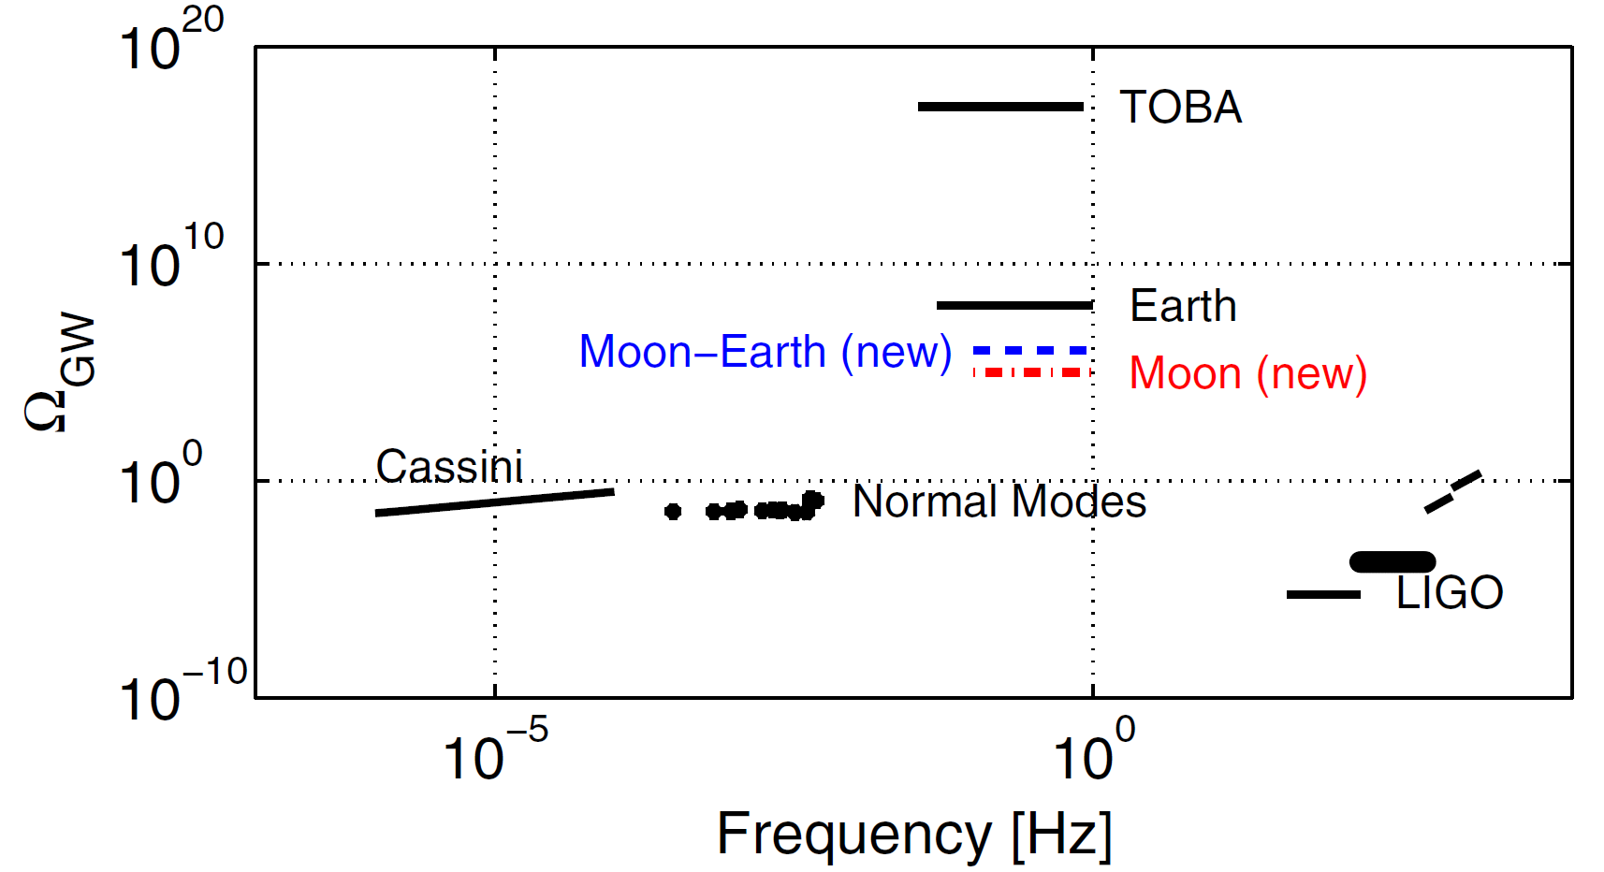
Results of 2014 Studies

Slide 8
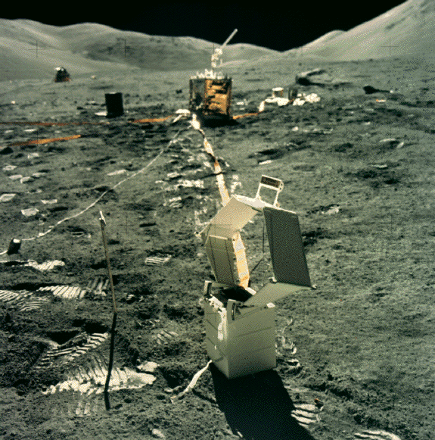
Apollo 17: Lunar Surface Gravimeter
The LSG would have set the most stringent limits on the energy of a GW background at that time, but it had greatly reduced sensitivity to due a design flaw.
NASA, Apollo 17 (1972)

Slide 9
Lunar GW Detection, 2020
LSGA (my projection: < 50mHz)
Laser-interferometric seismic strainmeter
Is necessarily inferior to LGWA at frequencies where the (random) seismic background dominates
Relies mostly on known technologies
Katsanevas et al
GLOC (my projection: 0.1Hz – 10Hz)
Laser-interferometric gravitational strainmeter
It can beat LGWA sensitivity at frequencies where the background reduction method used in LGWA meets its limits
Requires several new technologies
Harms et al
Jani/Loeb

Slide 10
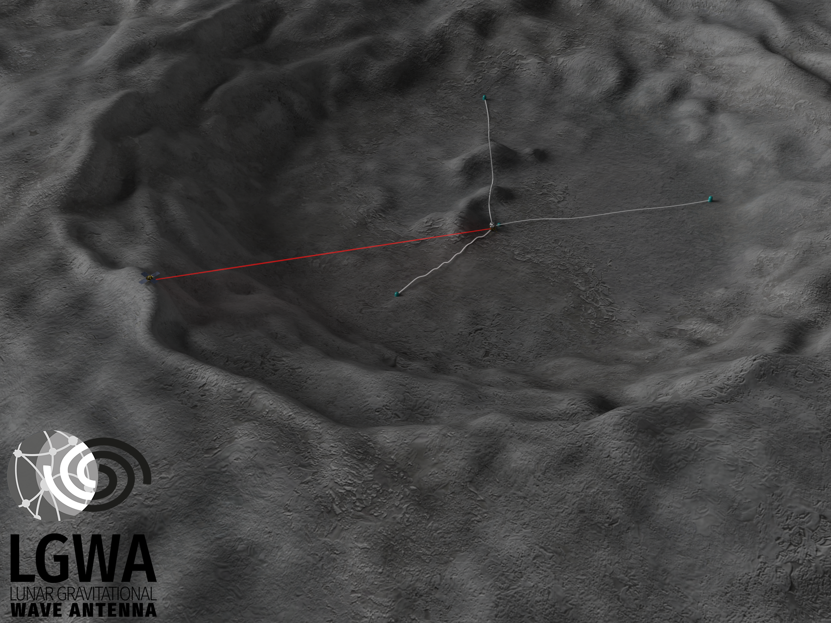
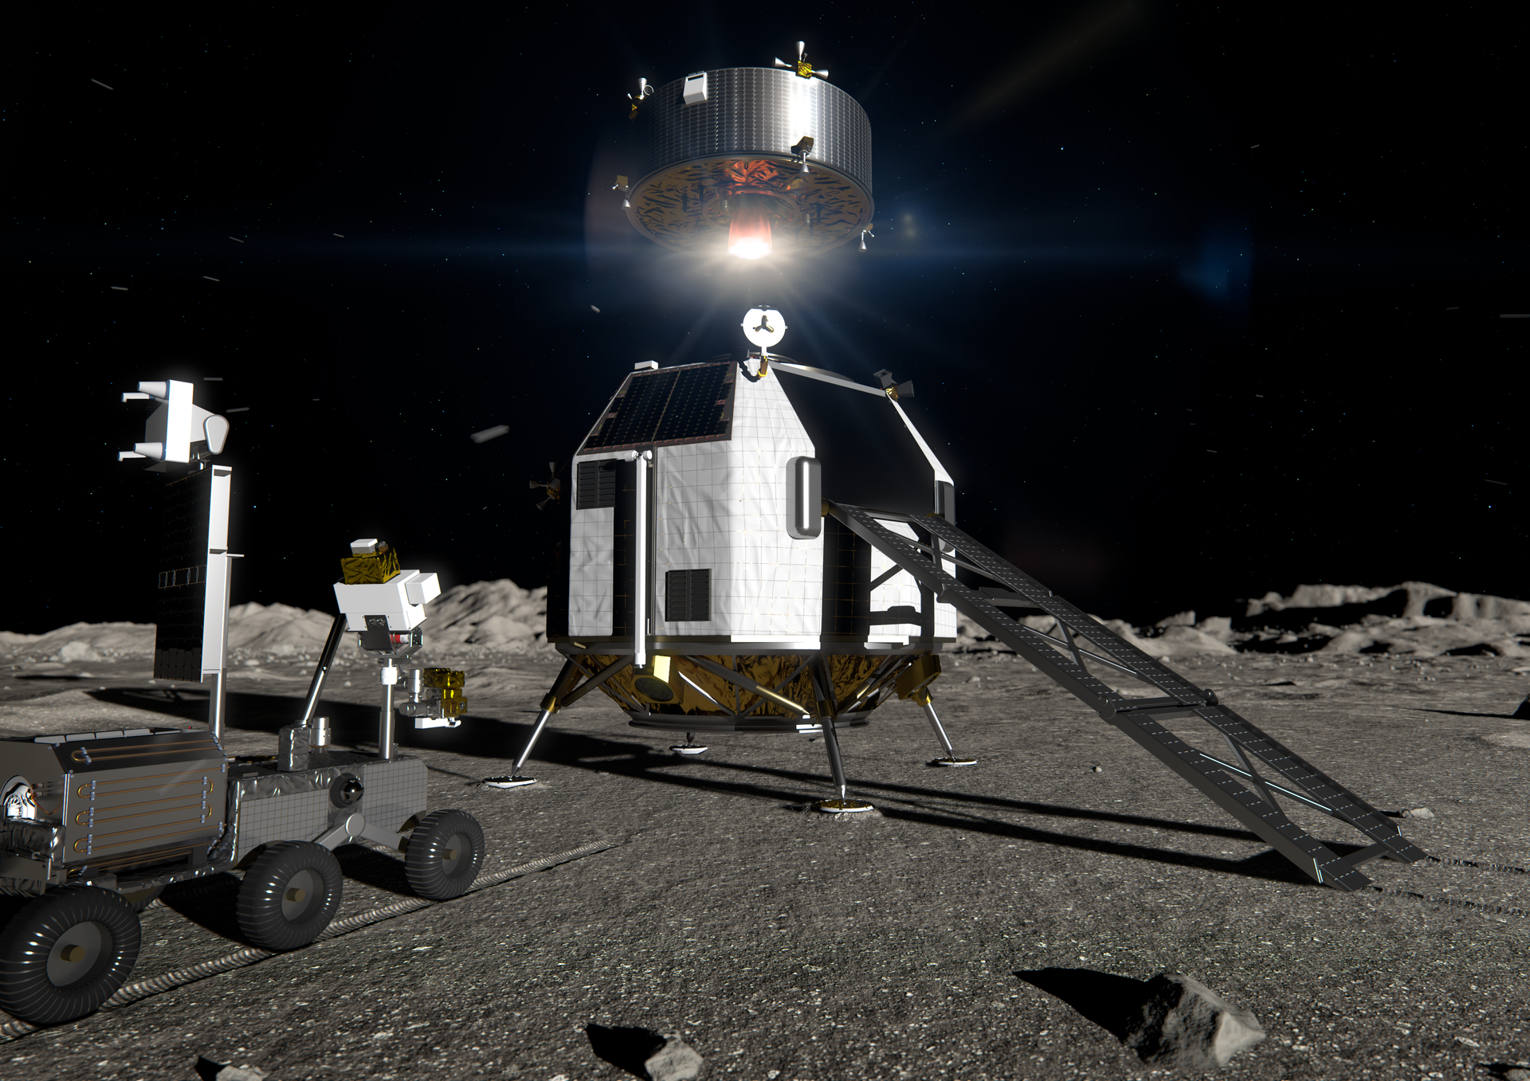
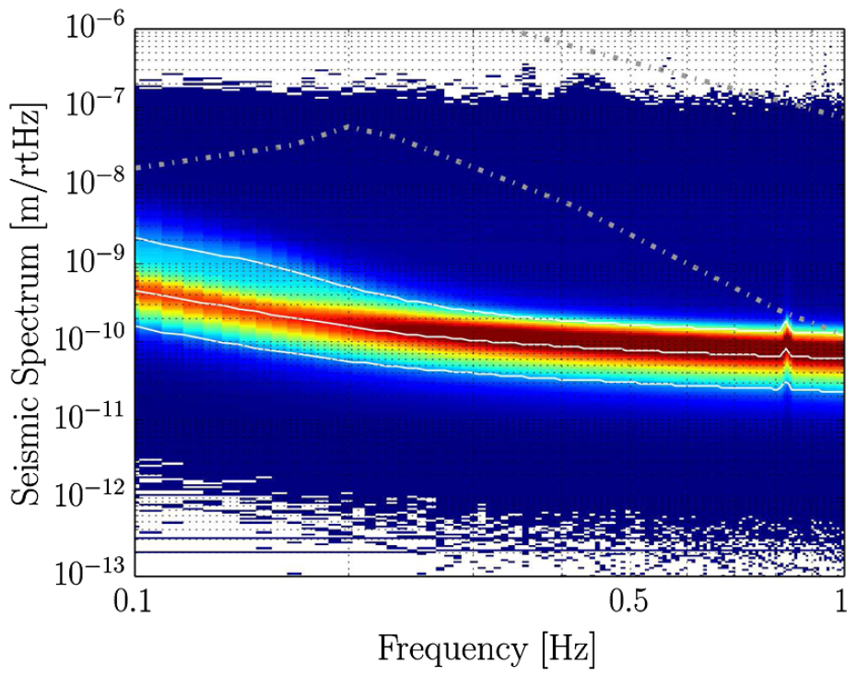
LGWA Concept
Lunar seismic spectra
Minimum on Earth
ESA’s EL3
Upper limit on lunar seismic background
km scale
Extremely weak seismic background
Data stretches with moonquakes, meteoroid impacts etc can be ignored or cleaned using coherent noise cancellation

Slide 11
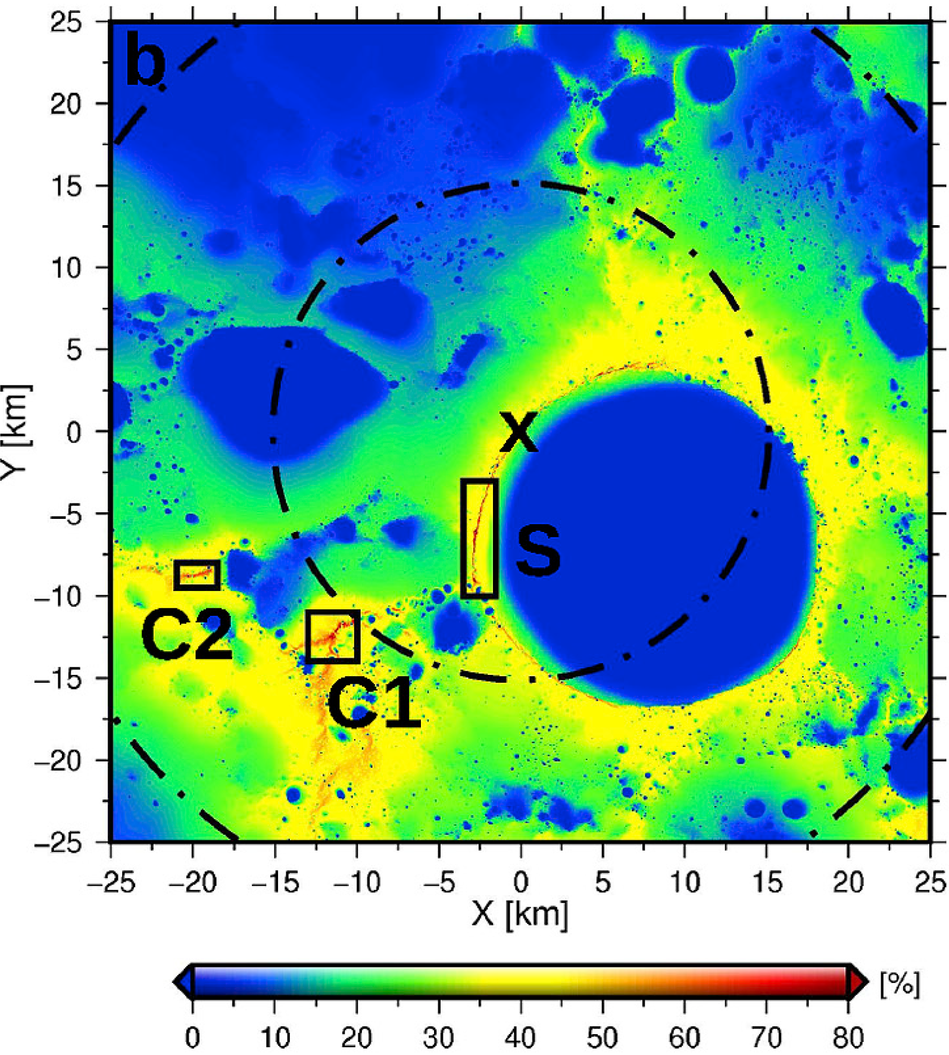
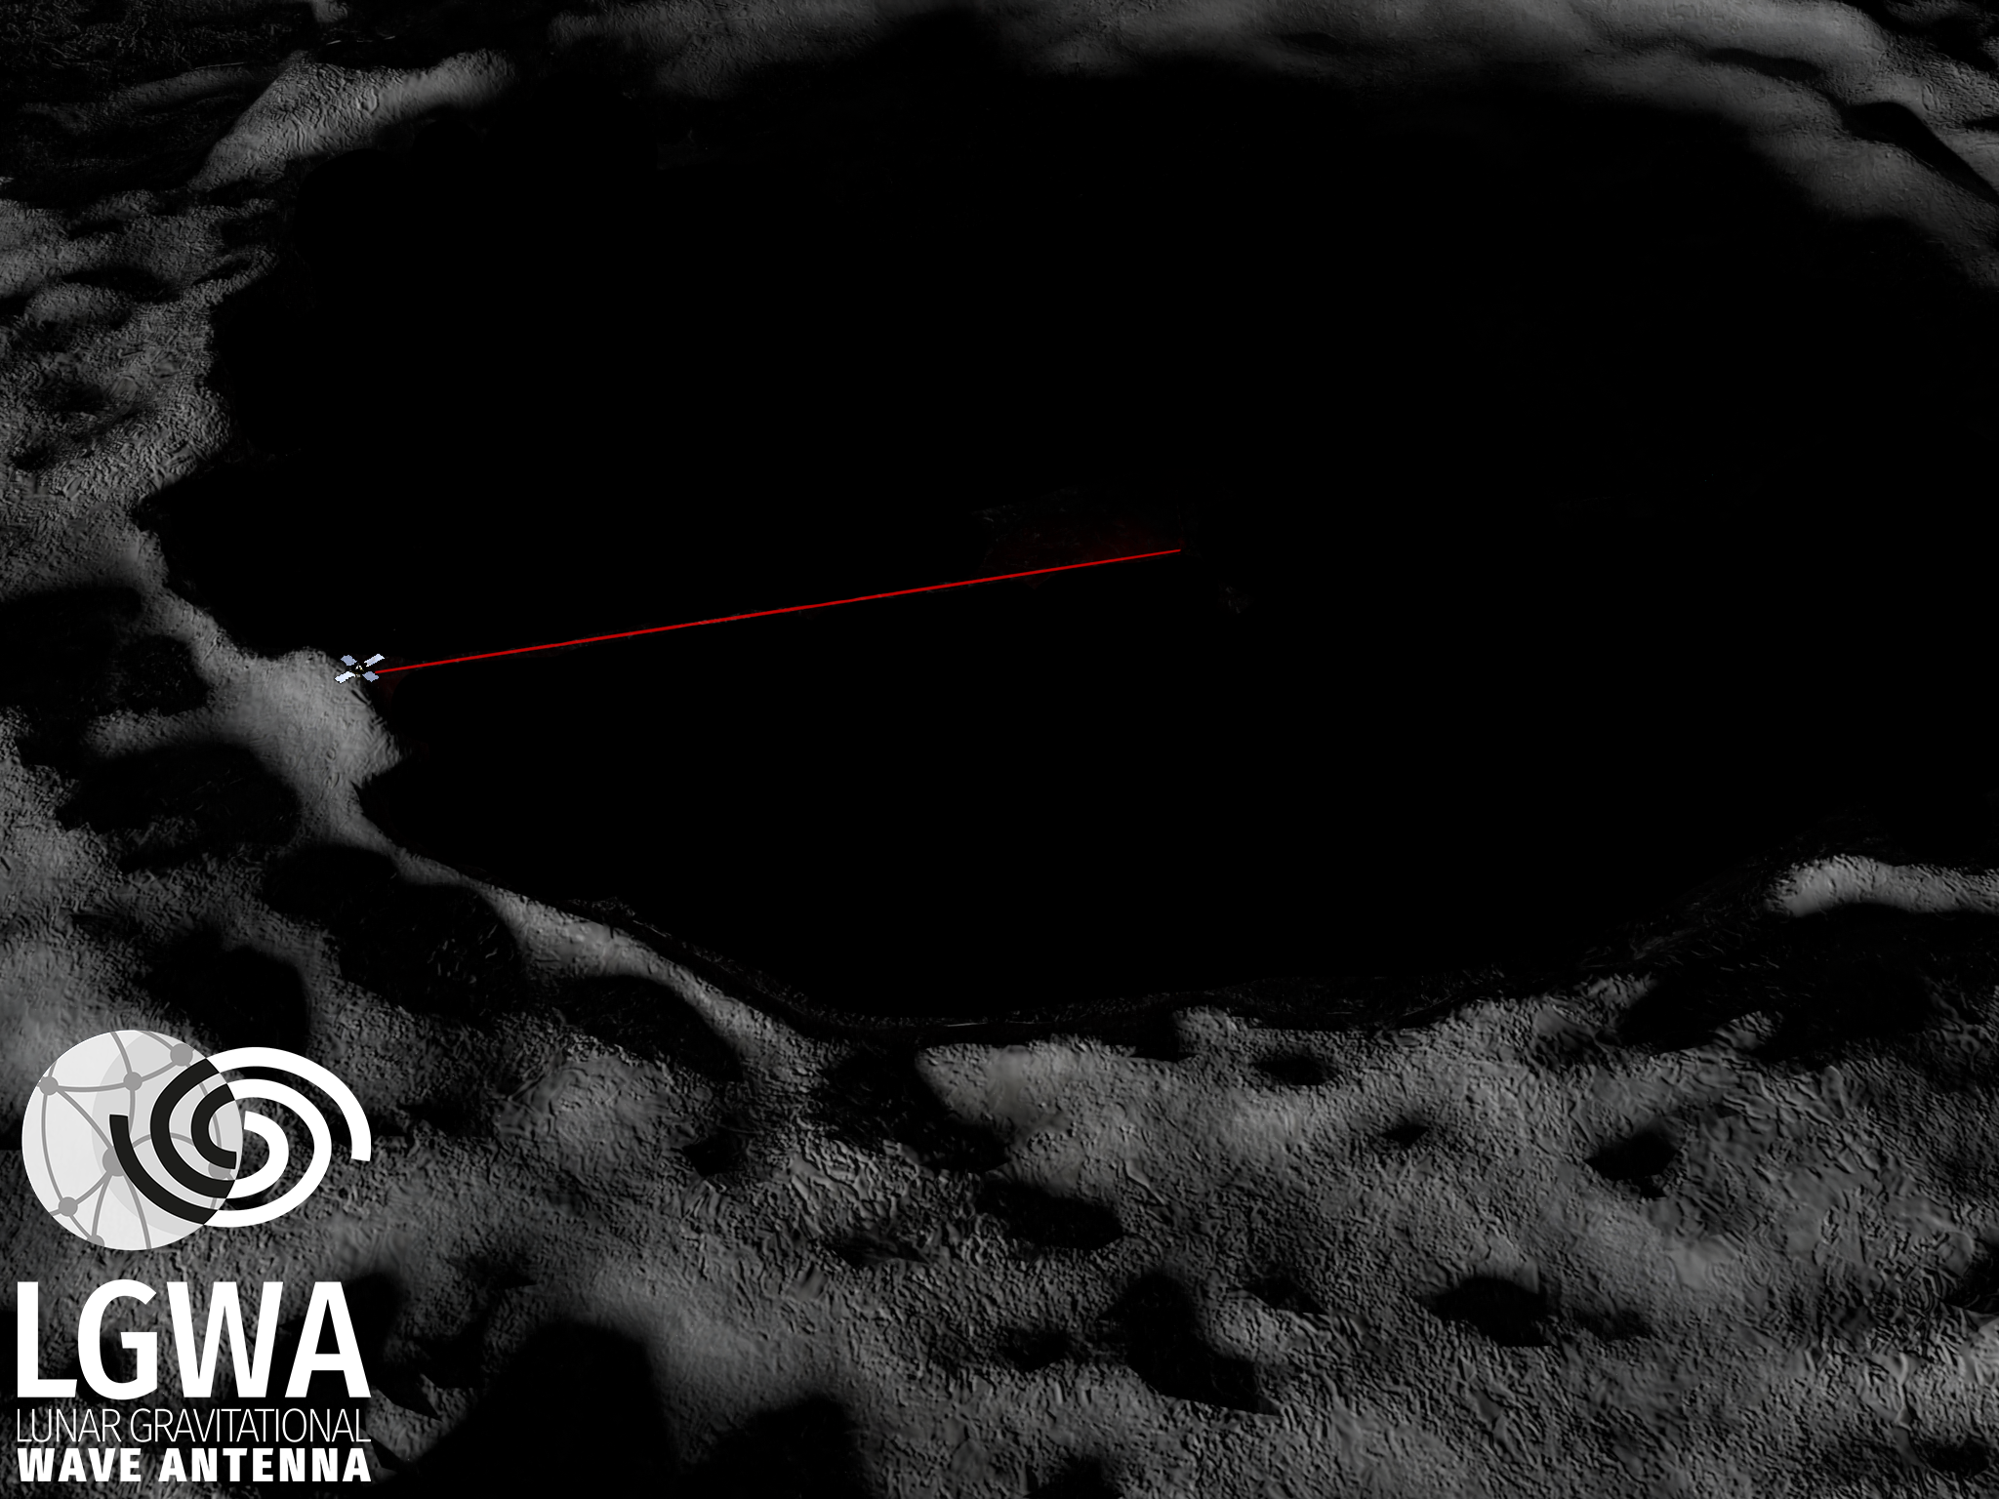
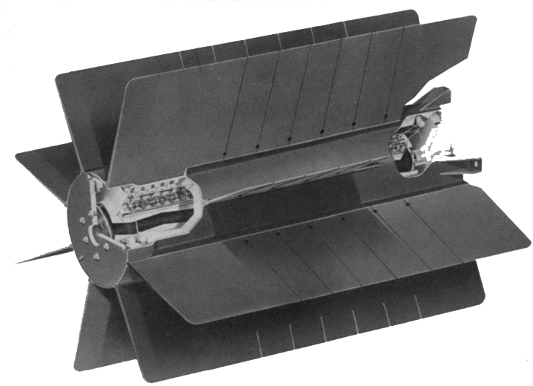
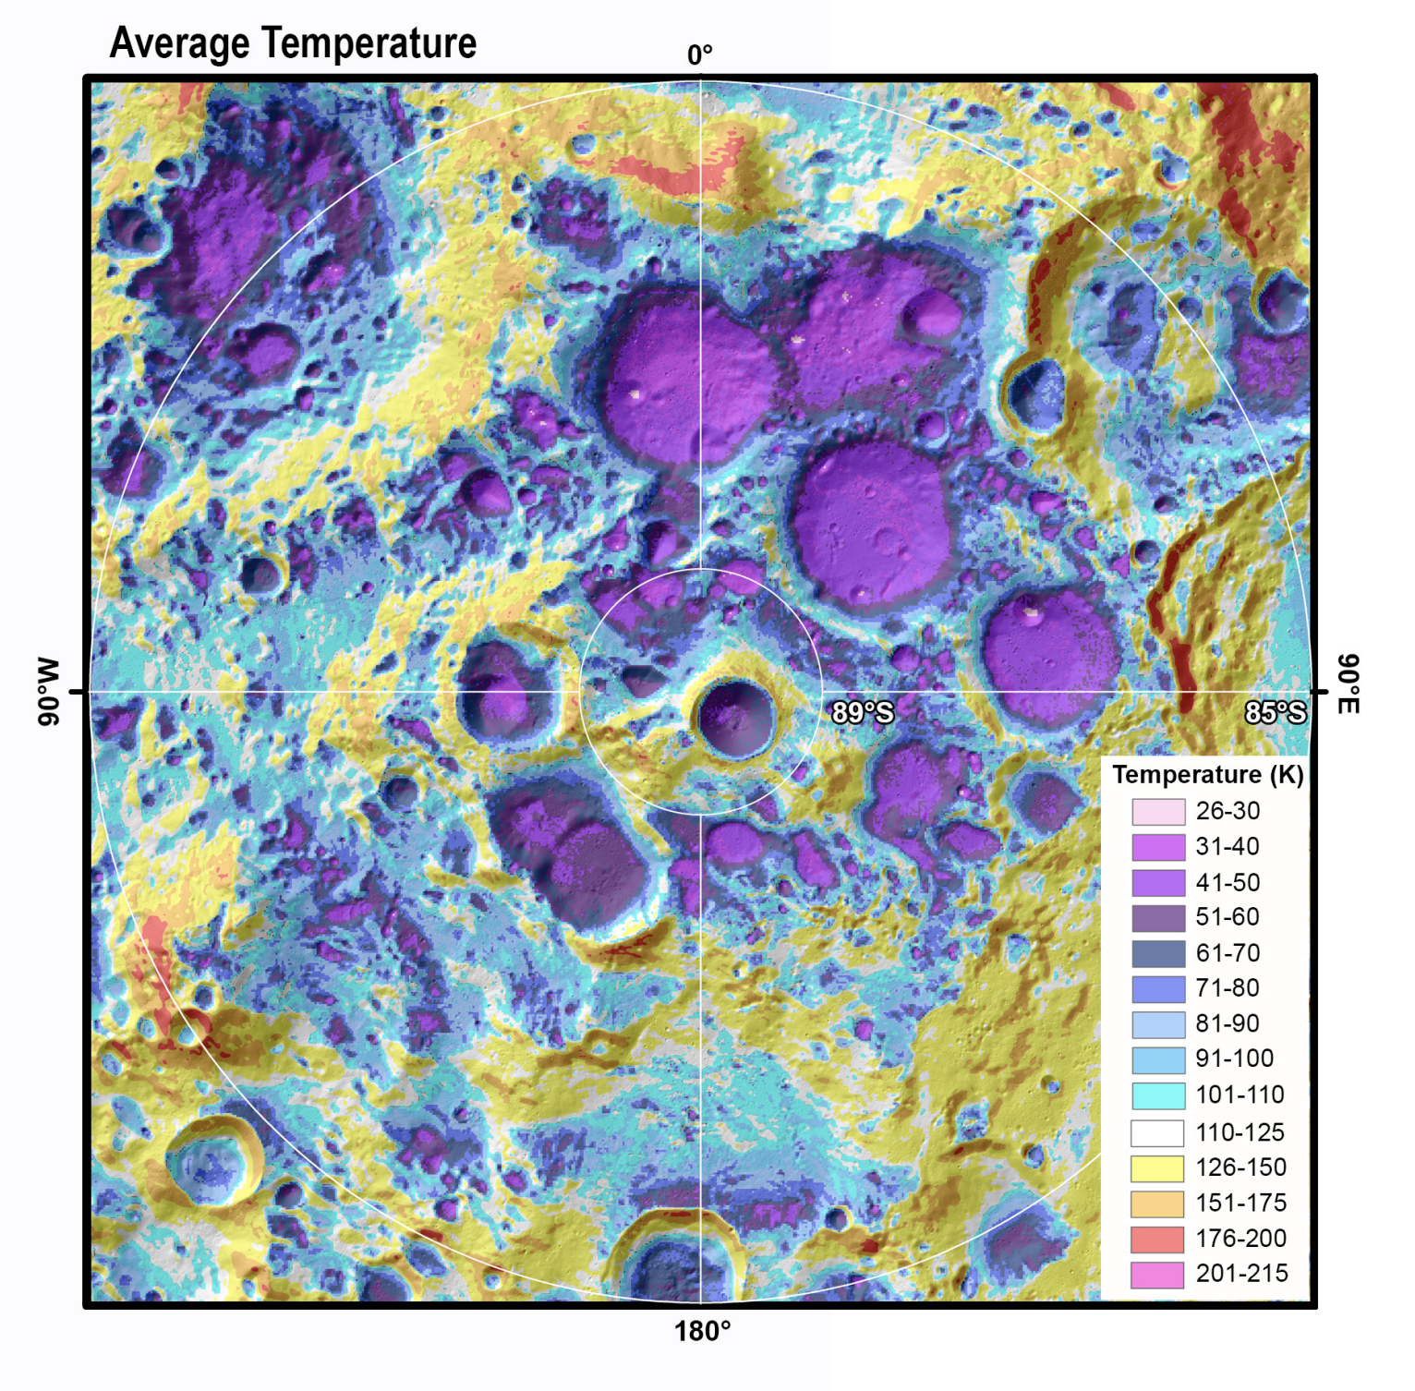
Powering
Array resides inside permanent shadow cast by craters at lunar poles
Sunshine illumination near south pole
Option 2:
Nuclear power
Option 1:
Laser power beaming
(or microwave)
Gläser et al, 2018
Temperature <40K in some permanent shadows of the lunar north and south poles.

Slide 12
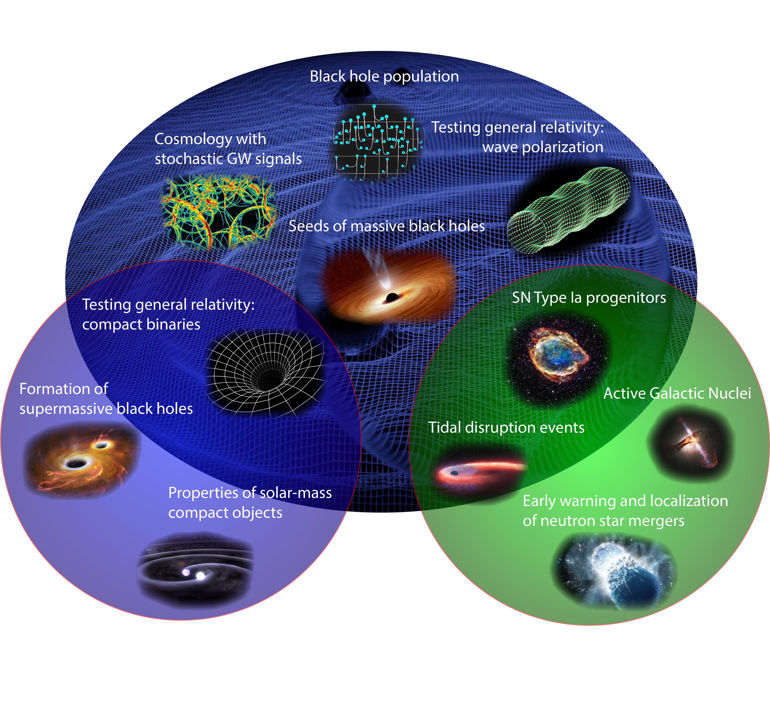

Slide 13
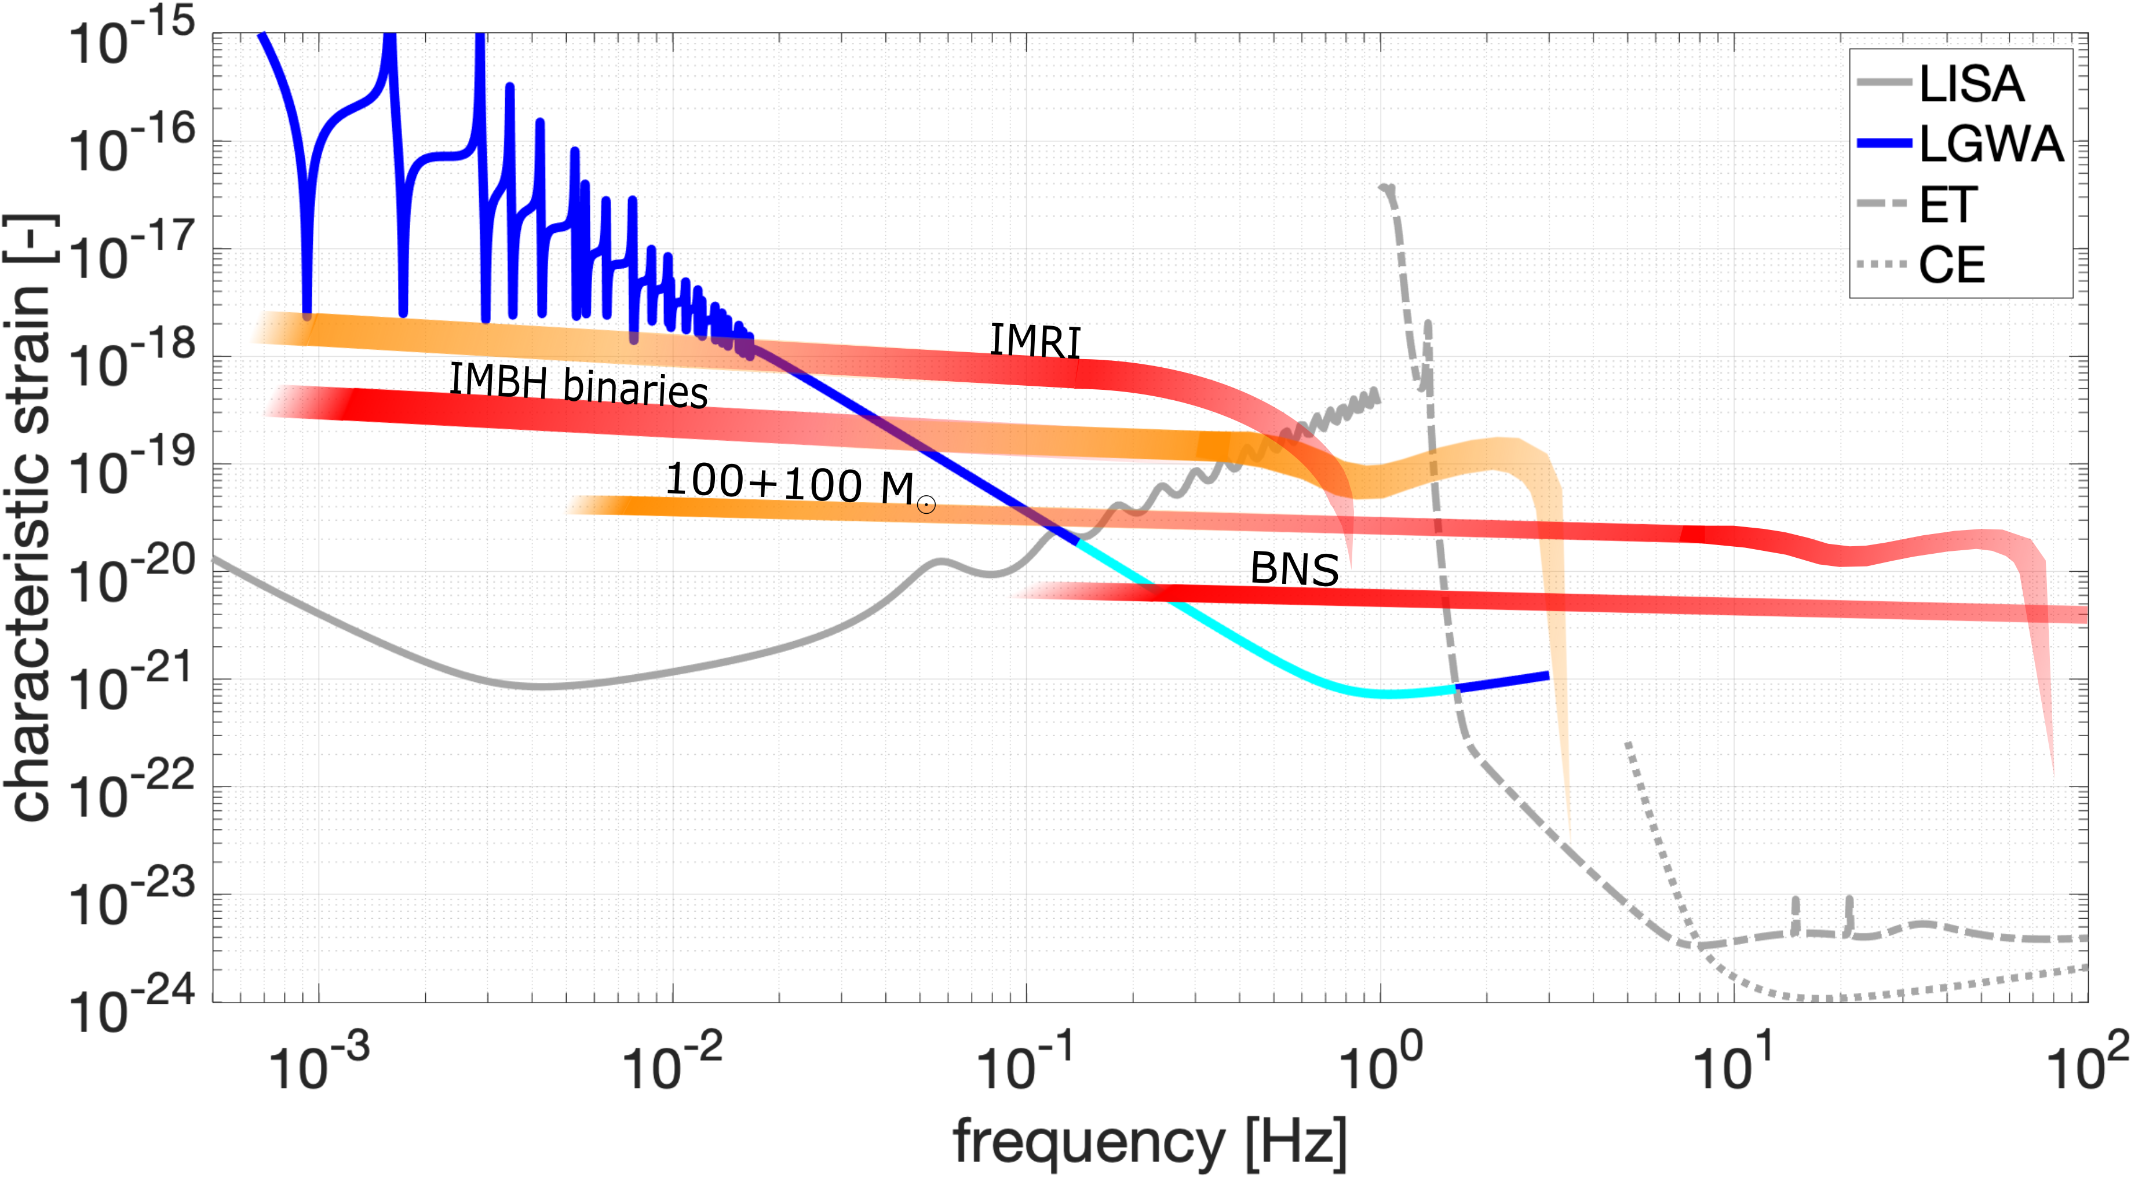
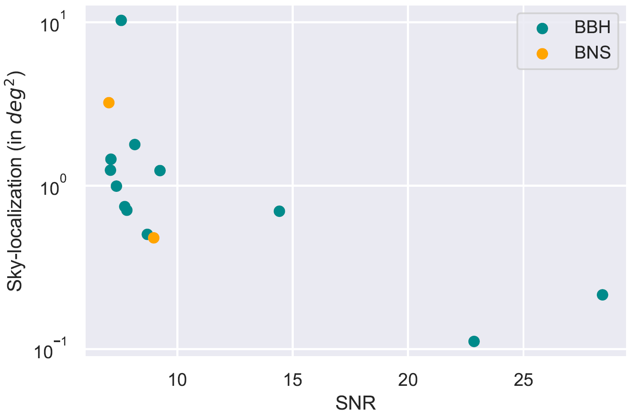
Multiband GW Observations
Yearly BNS and solar-mass BBH
detections and sky localization
(only those merging within 10 years)
Common GW signals with
LISA and ET/CE
BNS merger warning
A Oliveira (2021)

Slide 14
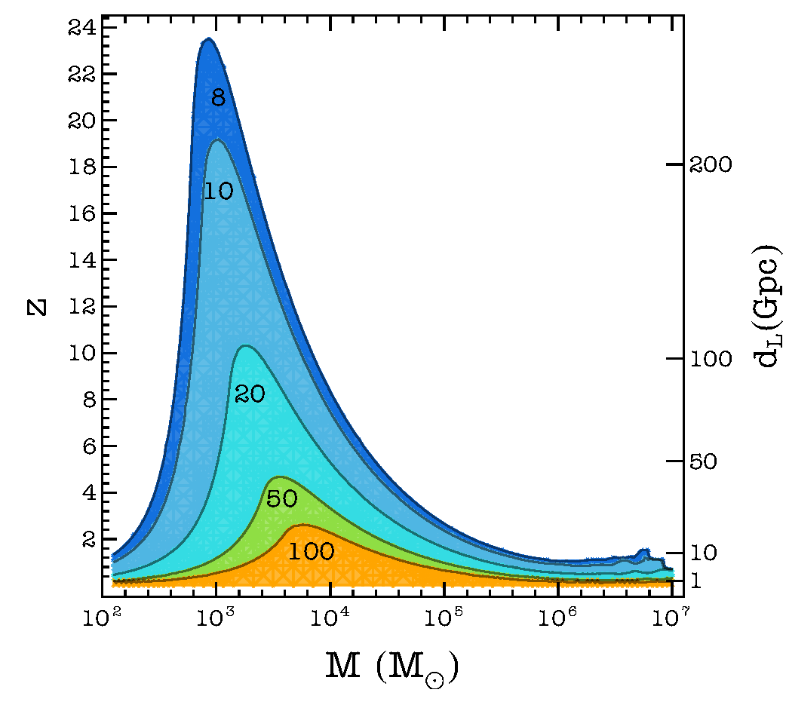
Intermediate to (Super)Massive Black-Hole Binaries
Detection range peaks for 10³ solar masses
Exploration of the full range of intermediate-mass BH binaries
Together with LISA and 3G, explore the full black-hole hierarchy, seeds of massive BHs in the early universe
Connects to ongoing AGN studies to reveal the presence of massive BH binaries in the nearby universe

Slide 15
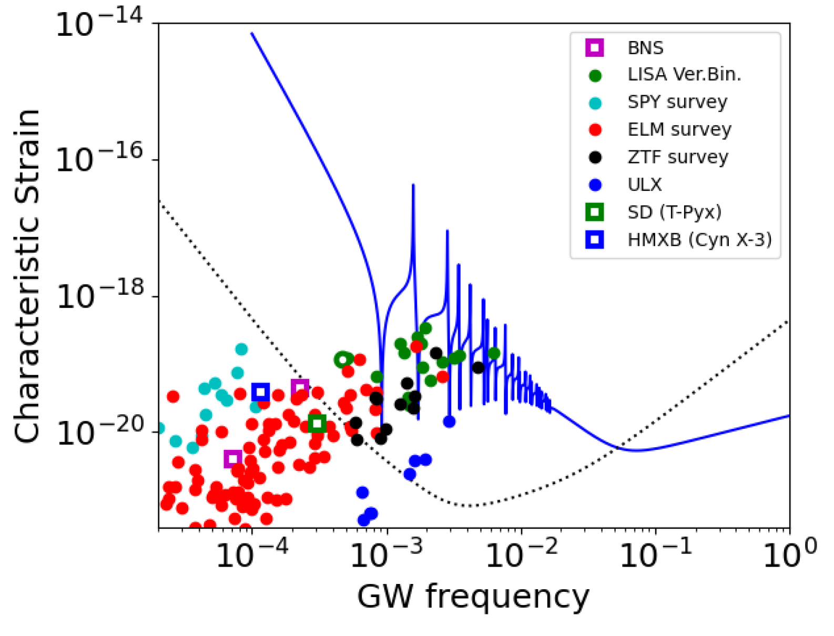
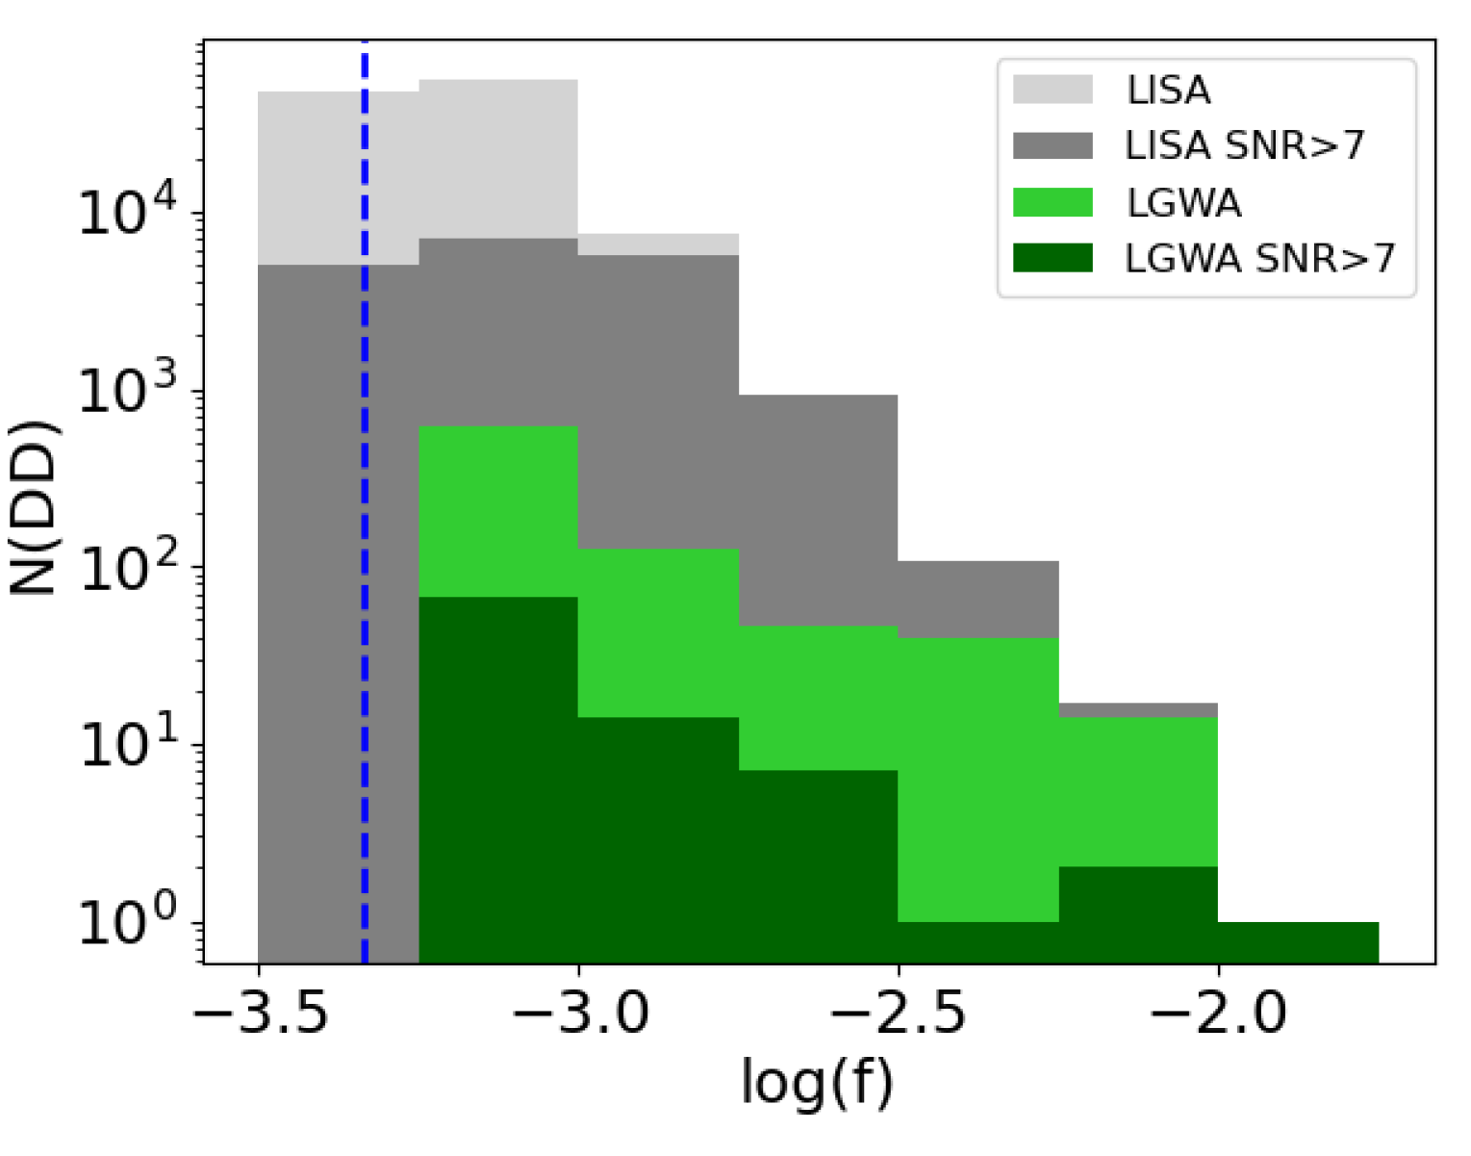
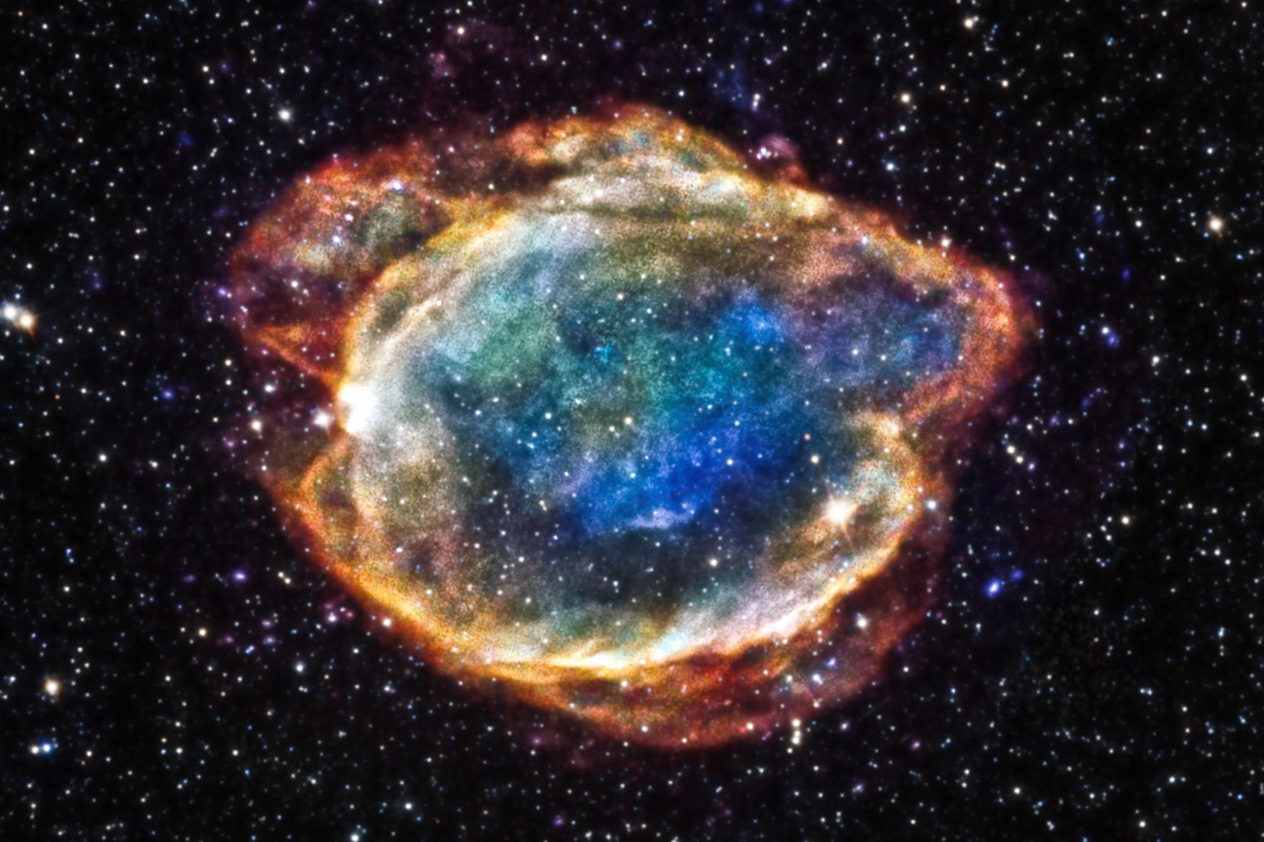
Galactic Binaries
Estimated GW amplitudes from known short-period binaries in the Galaxy.
Predicted number of detections
(one year observation time)
Probability of galactic WD/WD merger is low, but it would be decisive for SN Ia progenitor identification, and the long lifetime of the LGWA mission is important for this study.

Slide 16
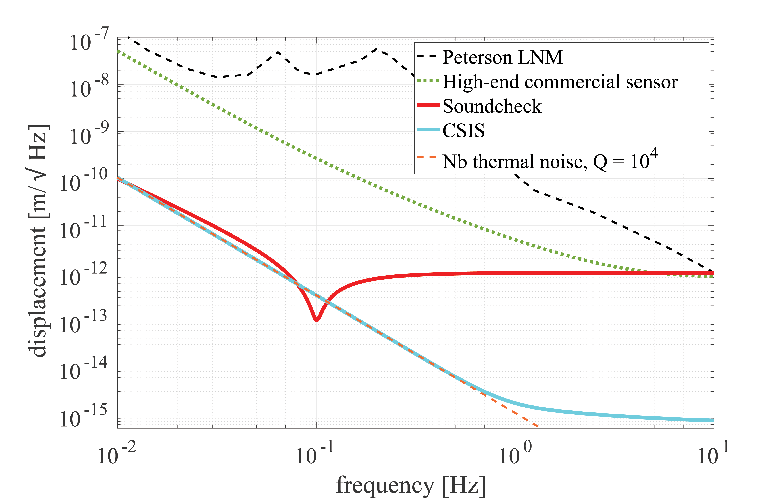
Sensor Noise Targets
LGWA Soundcheck is necessary to learn more about seismic background inside a PSR
LGWA readout is less complex than the LPF interferometer
Straight-forward measures will lead to the sensitivity requirement for LGWA
LPF readout

Slide 17
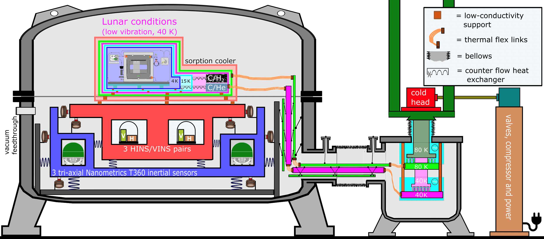
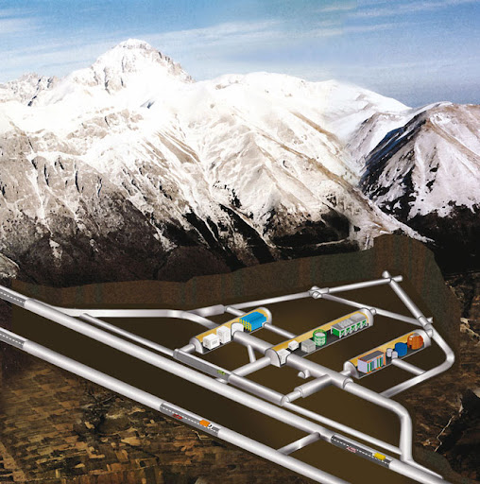
Planned LGWA Facility
For LGWA payload testing, ultra-quiet seismic environment is required → underground inertial platform
Moon Emulator &
LGWA sensor
INFN LNGS near L’Aquila
Cryogenic niobium Watt’s linkage
Ultra-low vibration 4K He/H sorption cryocooler

Slide 18
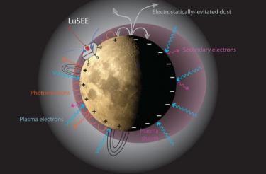
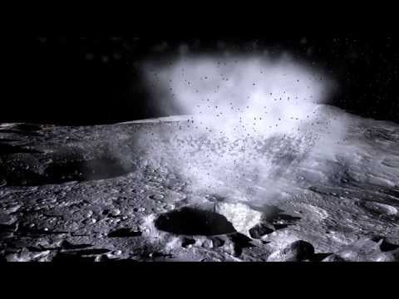
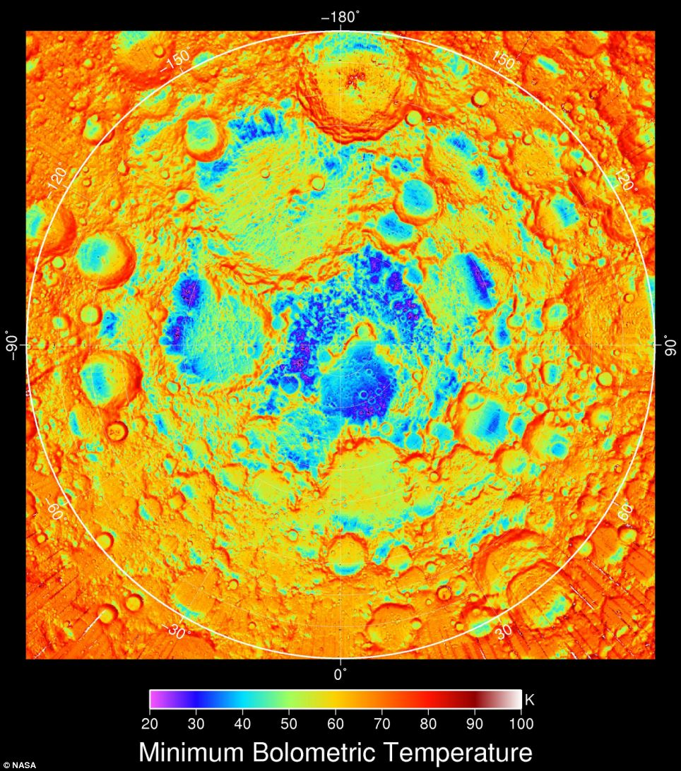

LGWA’s Physical Environment
Future lunar geophysical missions:
Farside Seismic Suite (approved, 2024/25)
Lunar Geophysical Network (proposed, early 2030s)
Moon as a spherical detector
Seismic background
Moon’s internal structure
Important environmental factors
Electromagnetic fields and charges
Temperatures and thermal fluctuations
Radiation
Dust
National Geographic

Slide 19


Next Steps
Background cancellation tests at Mt Etna
Mt Etna geology a good analog of lunar regolith
Collaboration with INGV
Probe methods for coherent noise cancellation developed for Virgo
LGWA Soundcheck
Pathfinder mission with shorter lifetime, single seismometer
Can be tested on already developed inertial platforms
Target: deployment before 2030
Nikhef Watt’s linkage
Demonstration at Mt Etna
(image: ROBEX)

