Slide 1
Lunar Gravitational-wave Antenna
Jan Harms
Gran Sasso Science Institute
INFN National Labs of Gran Sasso
lgwa.unicam.it

Slide 2
The LGWA Collaboration
Now 186 members from 18 countries
(Italy, India, USA, Germany, Switzerland,...)
Three working groups: «GW science and multi-messenger astronomy», «Lunar science and exploration», «Payload»
Important contributions from early-career scientists
Recent and future meetings:
  ISSI Forum in Bern, October 5-6, 2022
  LGWA white-paper kick-off meeting at GSSI, February 9-10, 2023
  Workshop on Lunar GW detection at ICTS, April 17-20, 2023
  LGWA meeting in Catania, October 9-13, 2023
  (www.ct.ingv.it/lgwa2023)

Slide 3
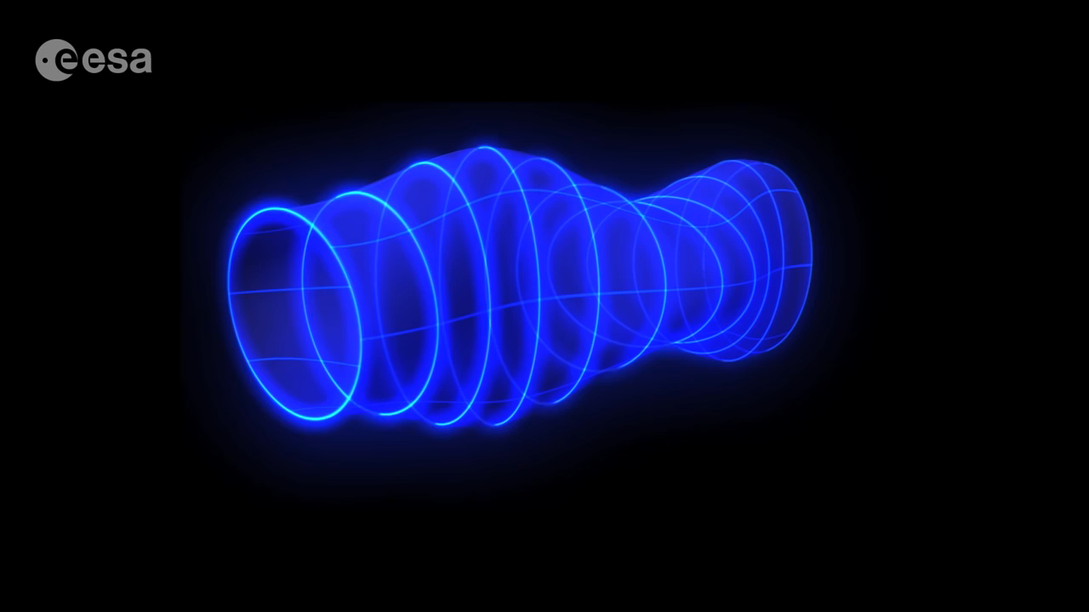

Slide 4
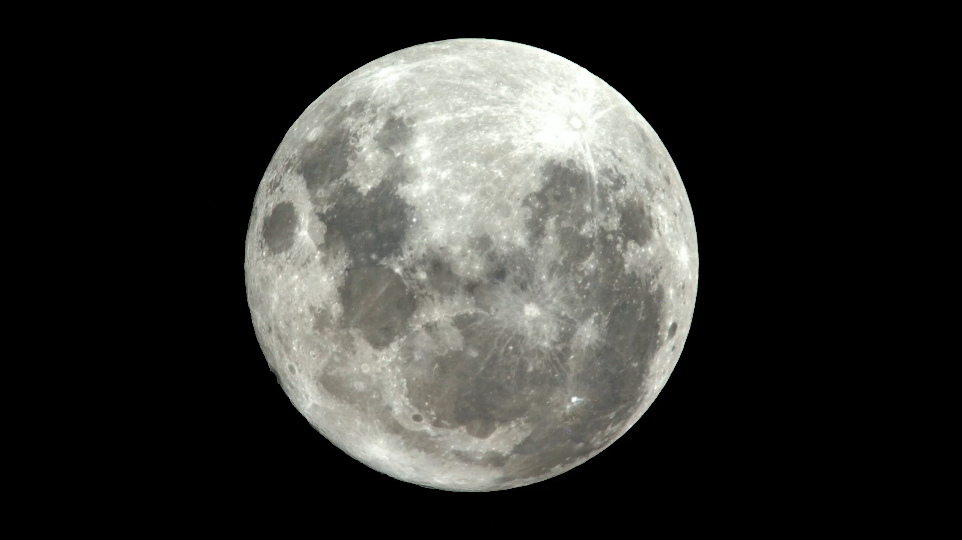
Quadrupolar vibration induced by a GW
(here showing spheroidal mode)
Notes:
Taking the Moon and turning it into a resonant antenna to listen to our Universe would be a huge cultural achievement, and for science, you cannot get closer to science fiction than this.

Slide 5
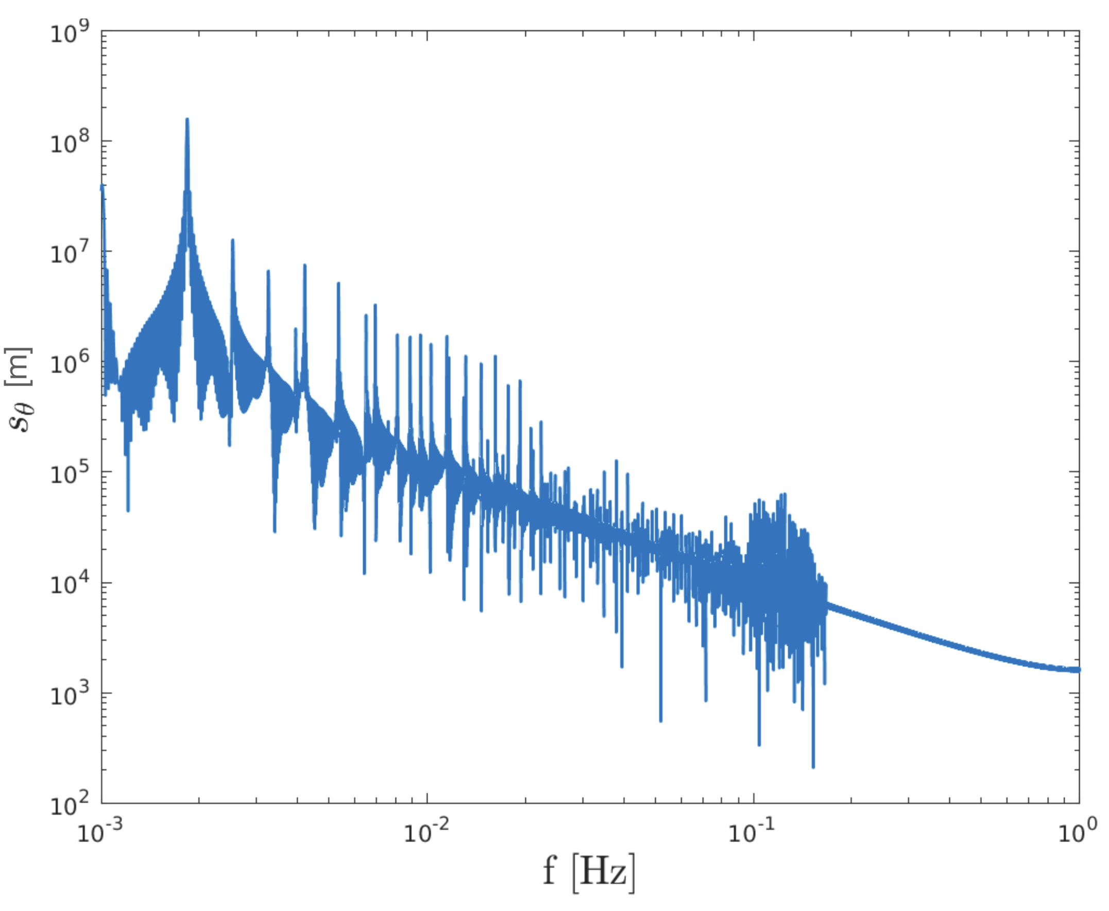
GW Response Model
Normal-mode simulation
Response in the dHz band depends on geology and topography.
Q-values of ground medium of a few 1000 inferred from Apollo seismic observations.
Finite-element simulations under preparation.
Features indicate mode Q-values of a few 10. Cannot explain Apollo observations.
J Majstorovic

Slide 6
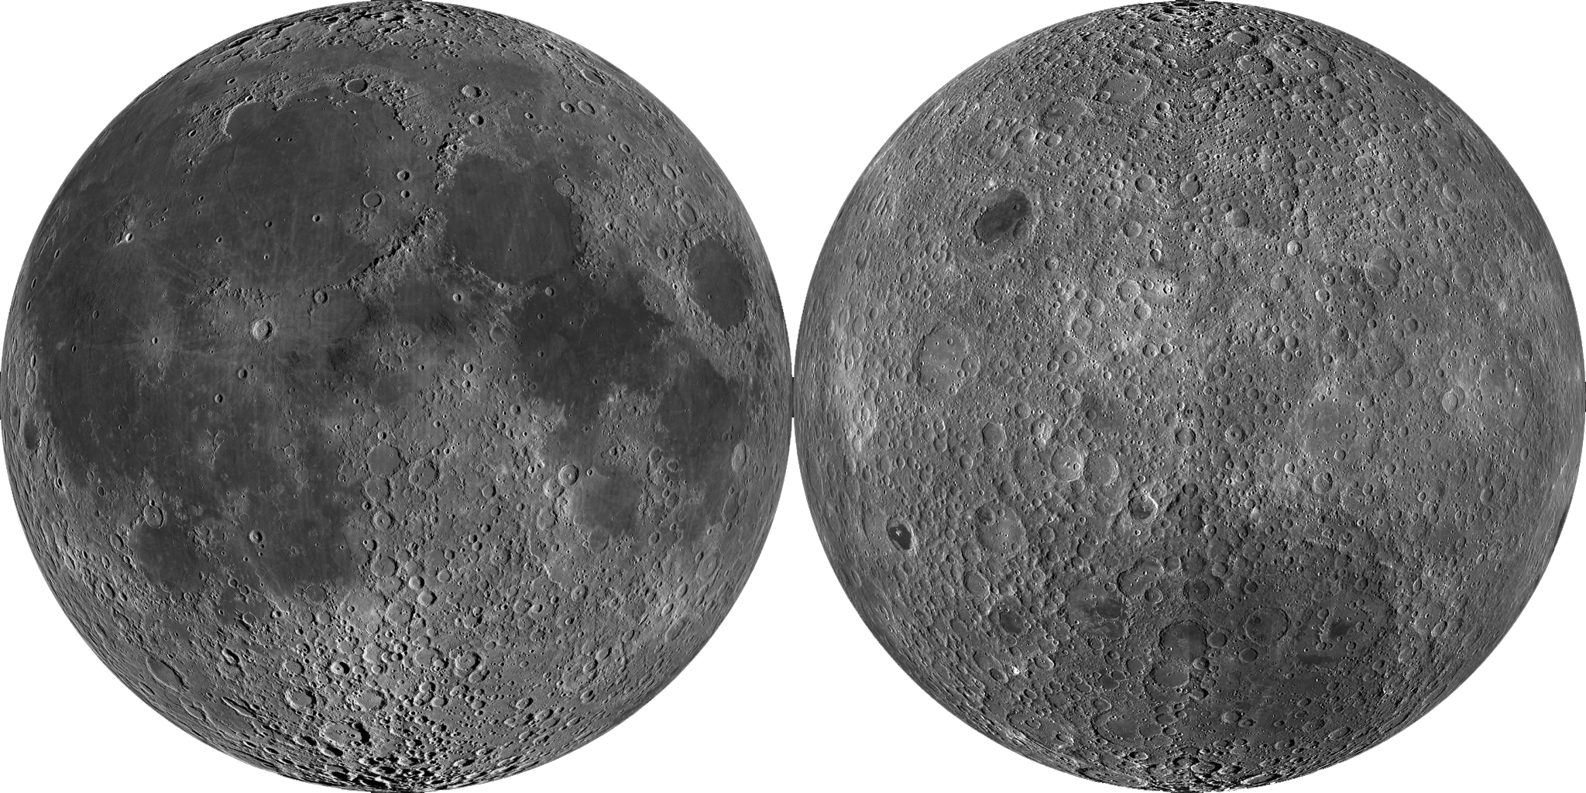
The Moon’s Surface
Near Side
Far Side
Notes:
Near side shows more signs of basaltic volcanism / lava flow: far side crust might be thicker

Slide 7
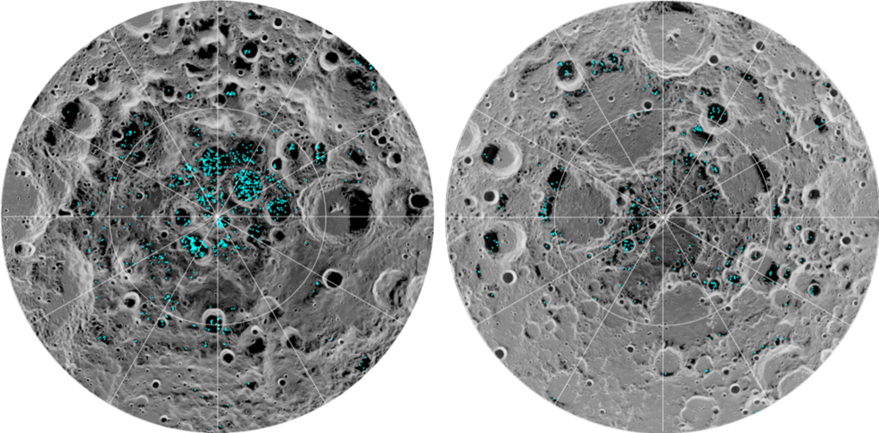
Why the South Pole?
South Pole
North Pole
NASA’s Moon Mineralogy Mapper

Slide 8
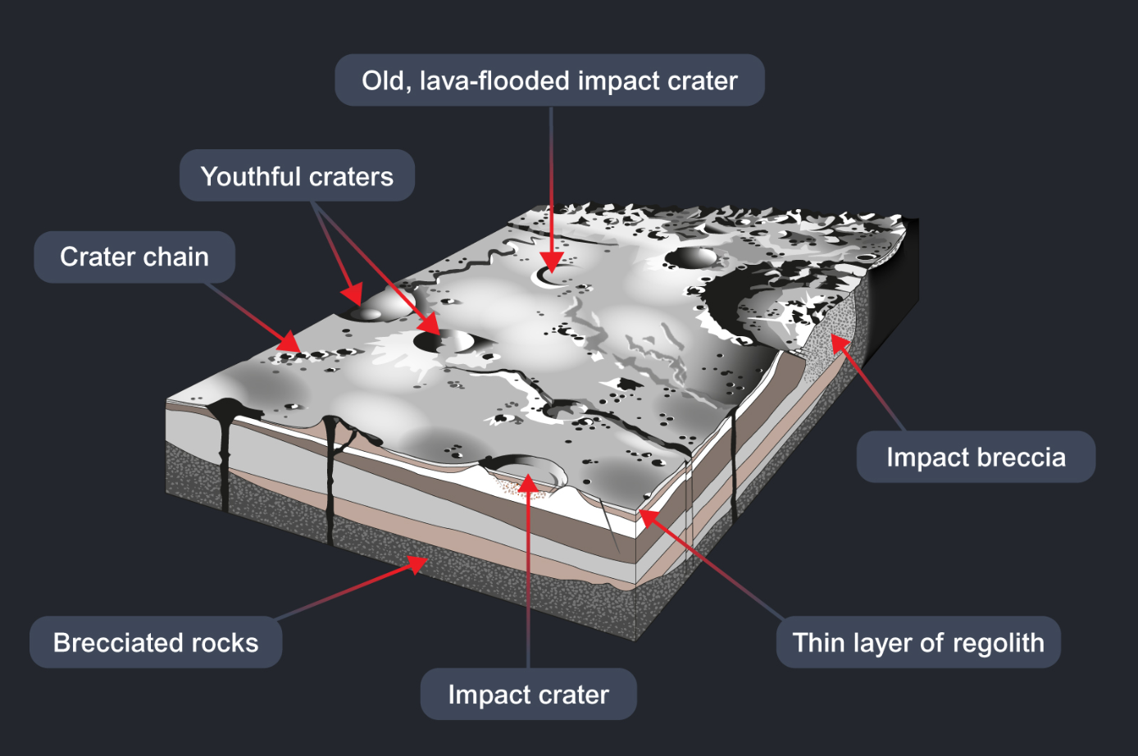
Source: open.ac.uk

Slide 9
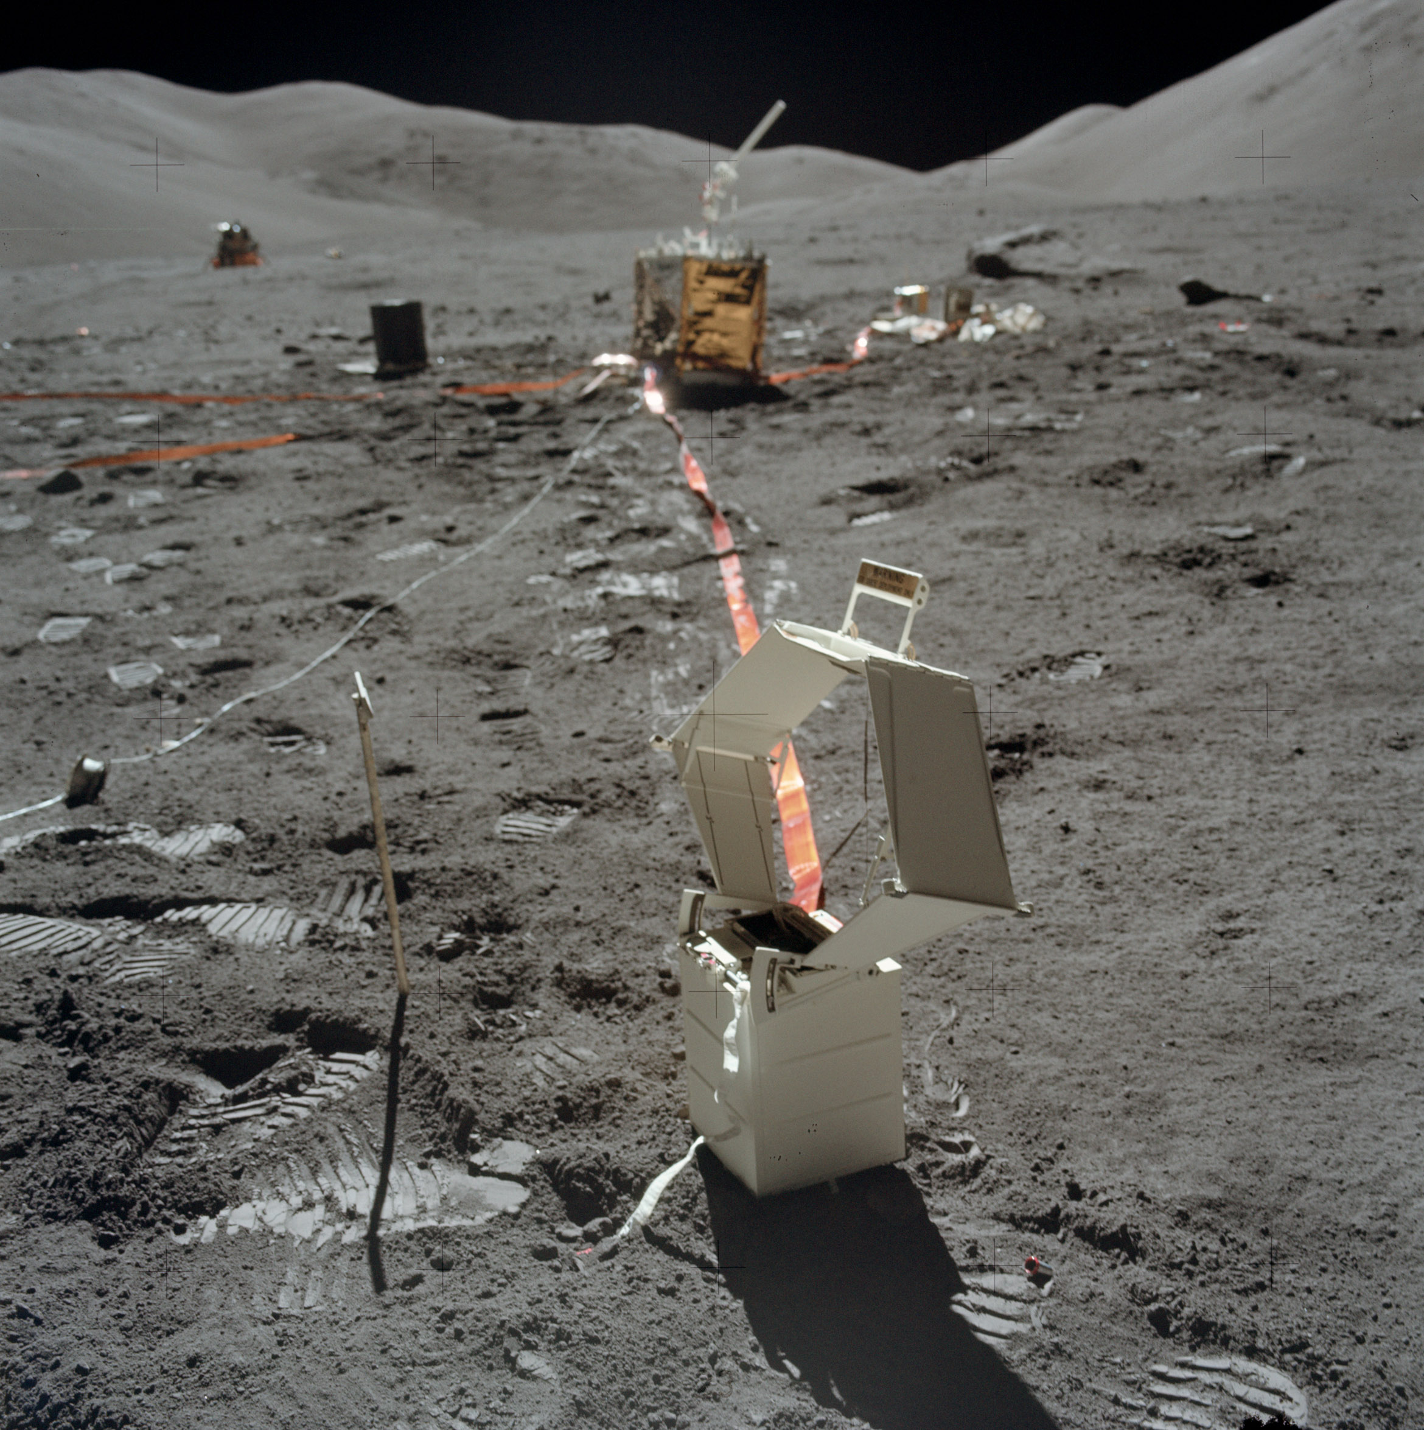
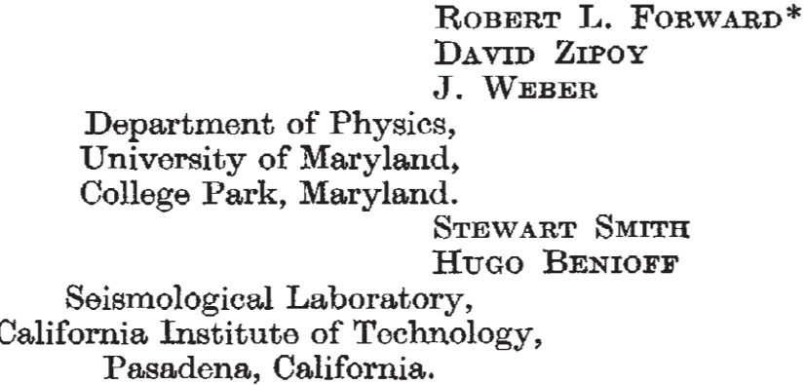
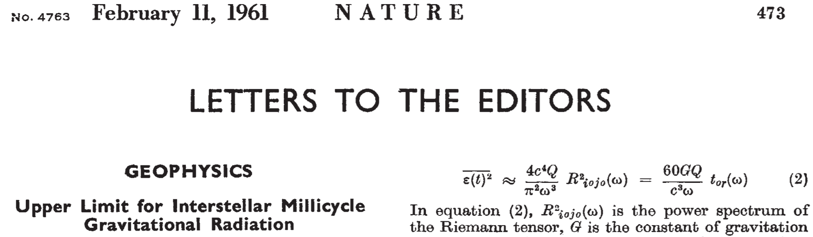
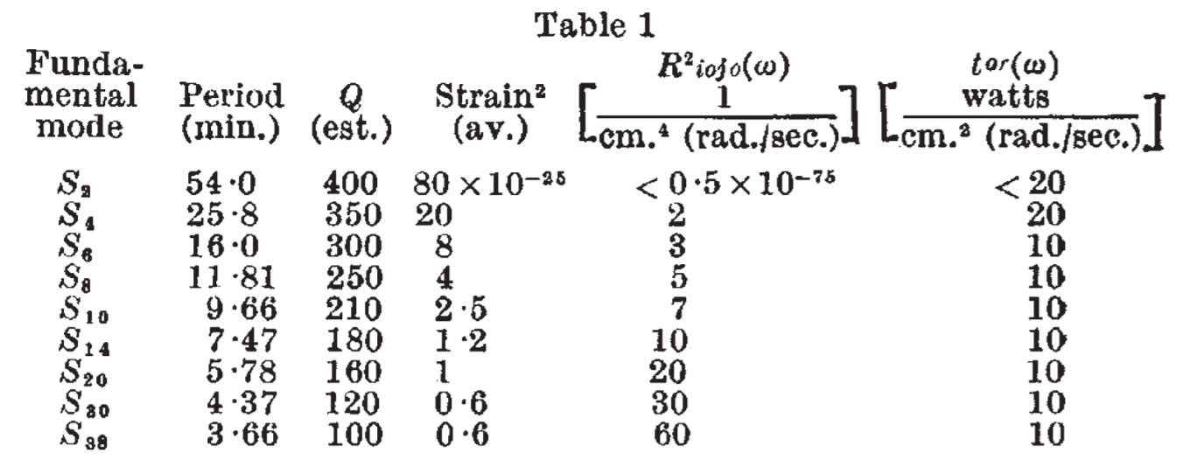
History
NASA, Apollo 17 (1972)
Data from N.32°W.
Benioff strain seismograph at Isabella, CA
Upper limits on Riemann-tensor power spectrum
Multiply with 8·10⁴⁹·(1mHz/f)⁴ to get GW strain PSD

Slide 10
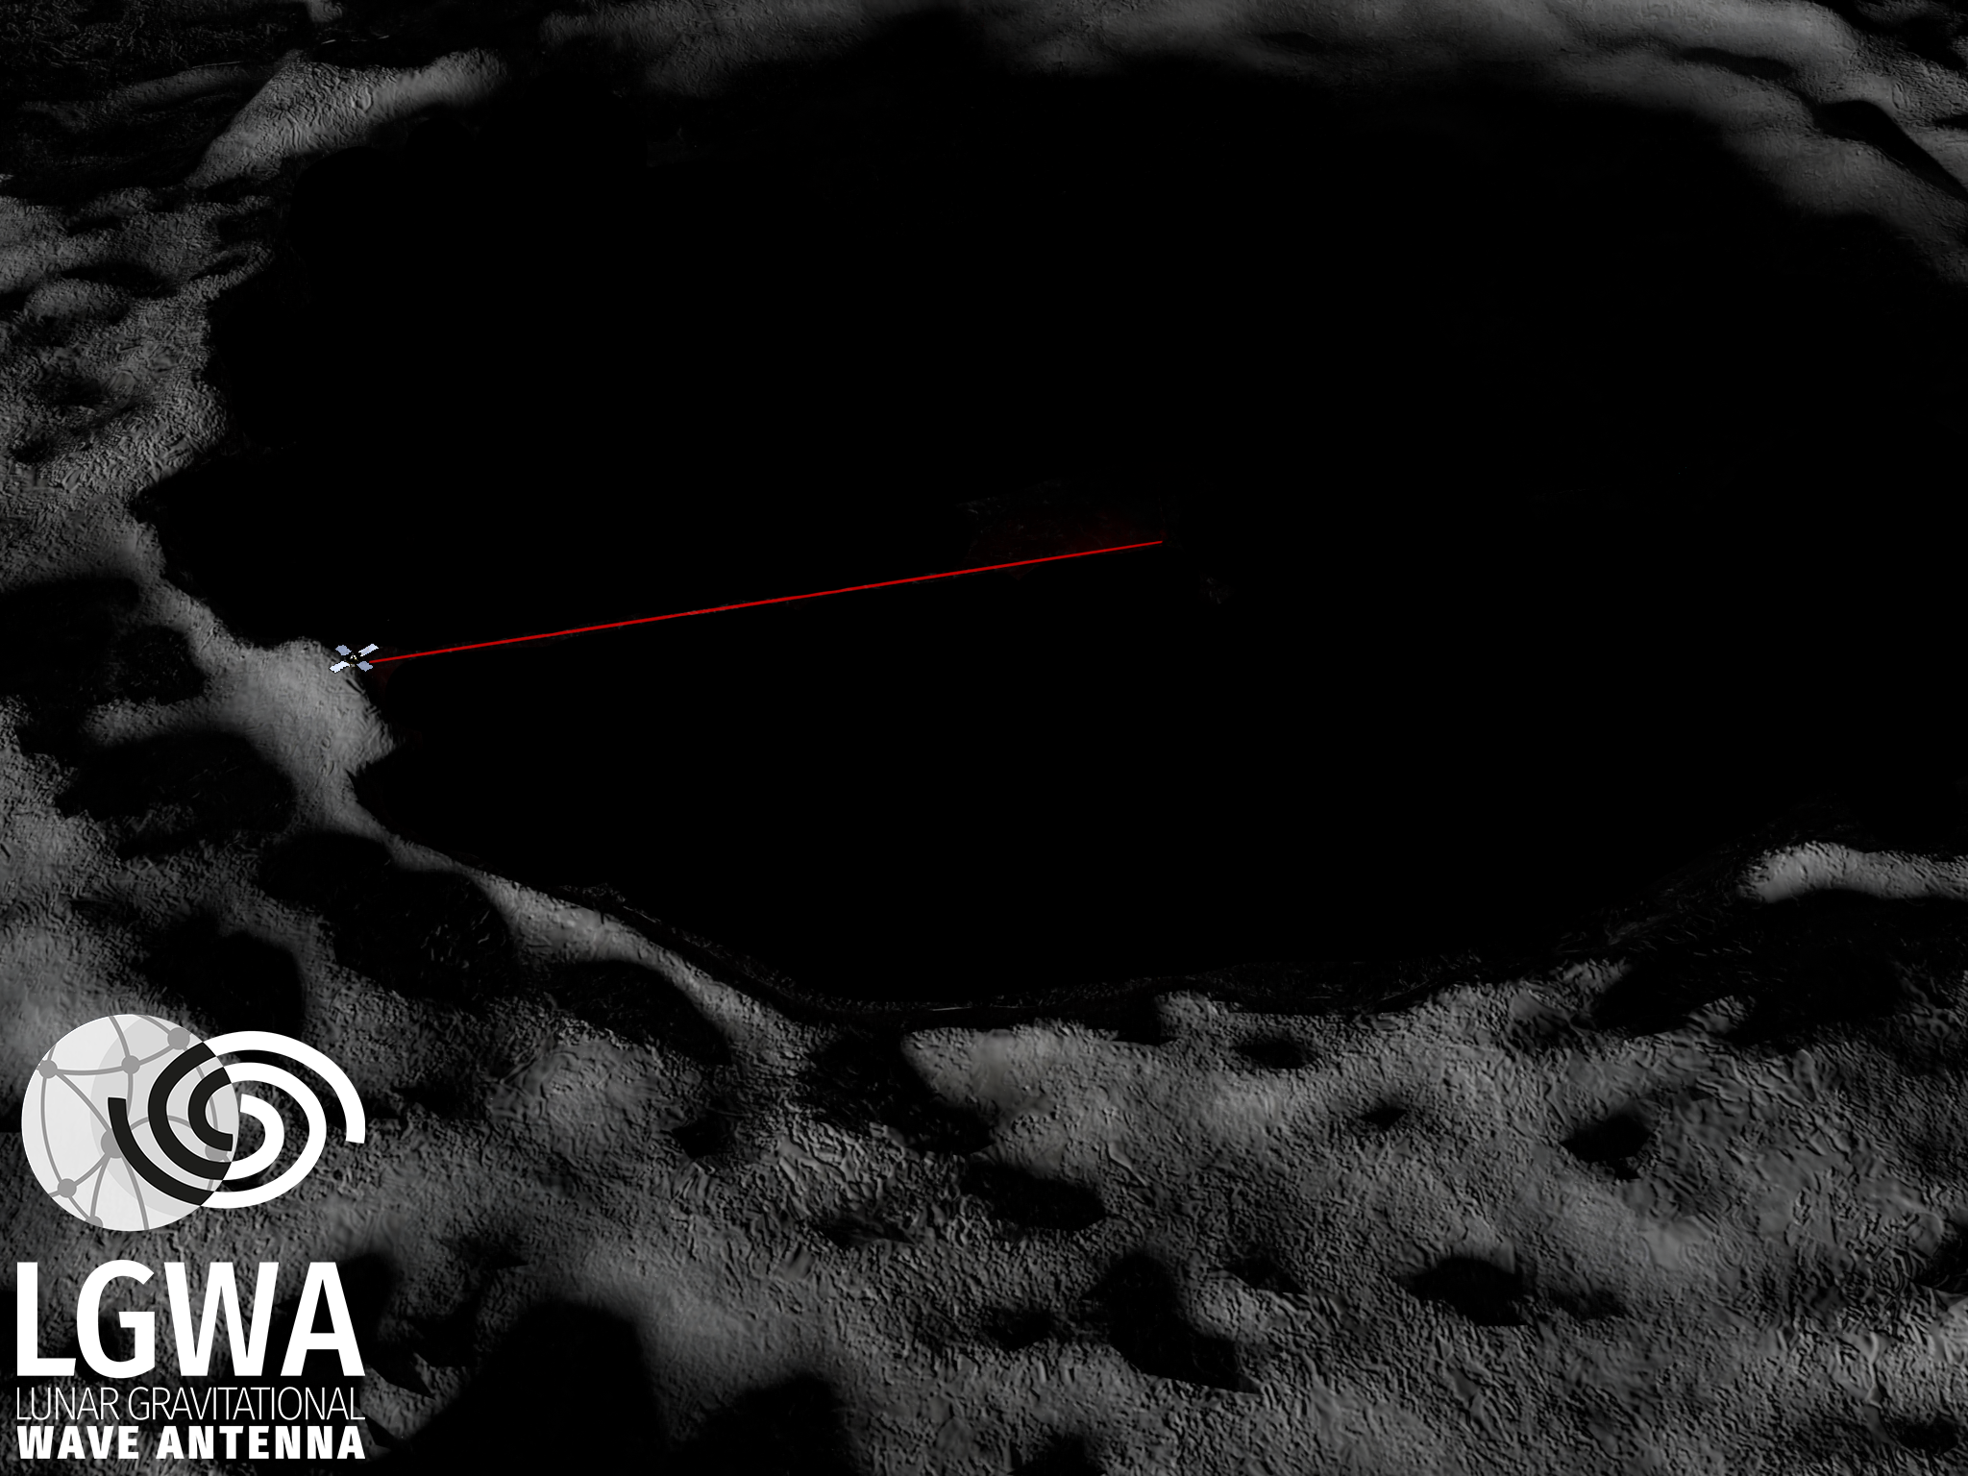
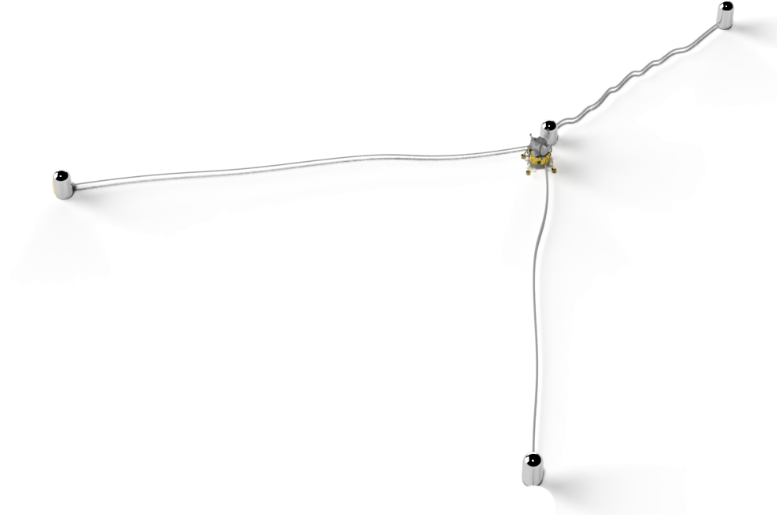
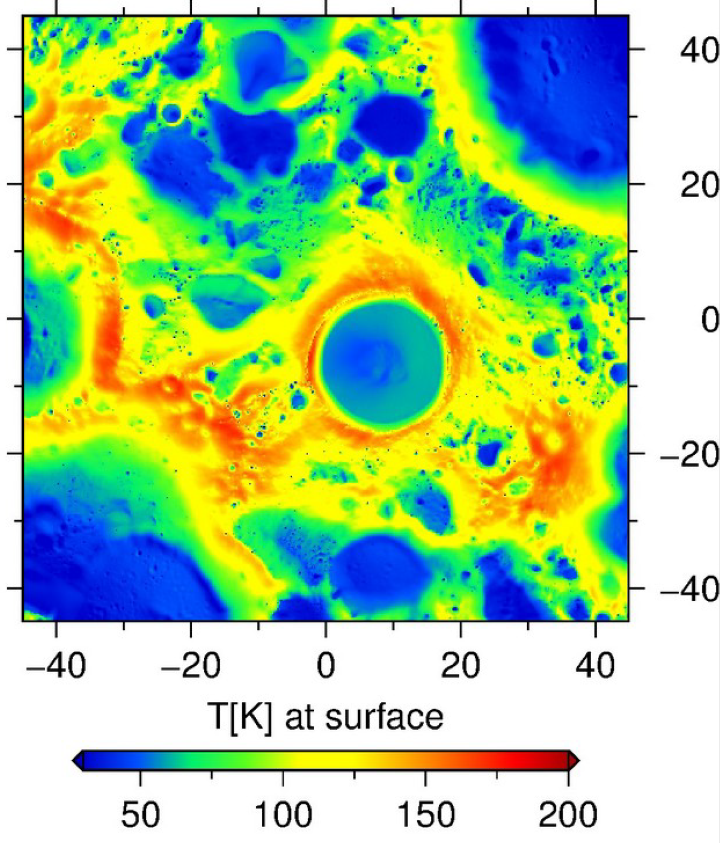
LGWA Concept
PSR: Extremely cold and stable surface temperatures
Array: cleaning data from seismic background noise
~ 1km

Slide 11
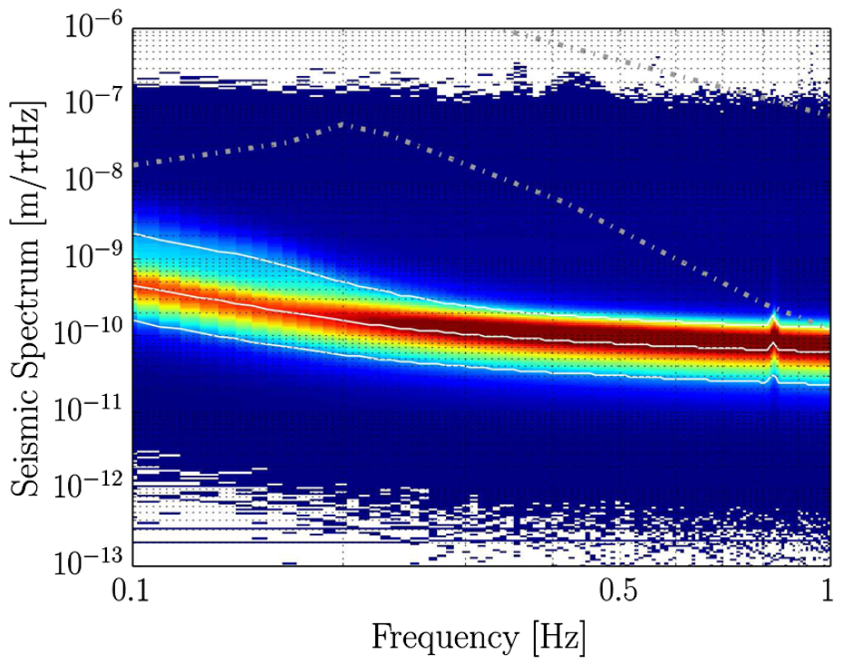
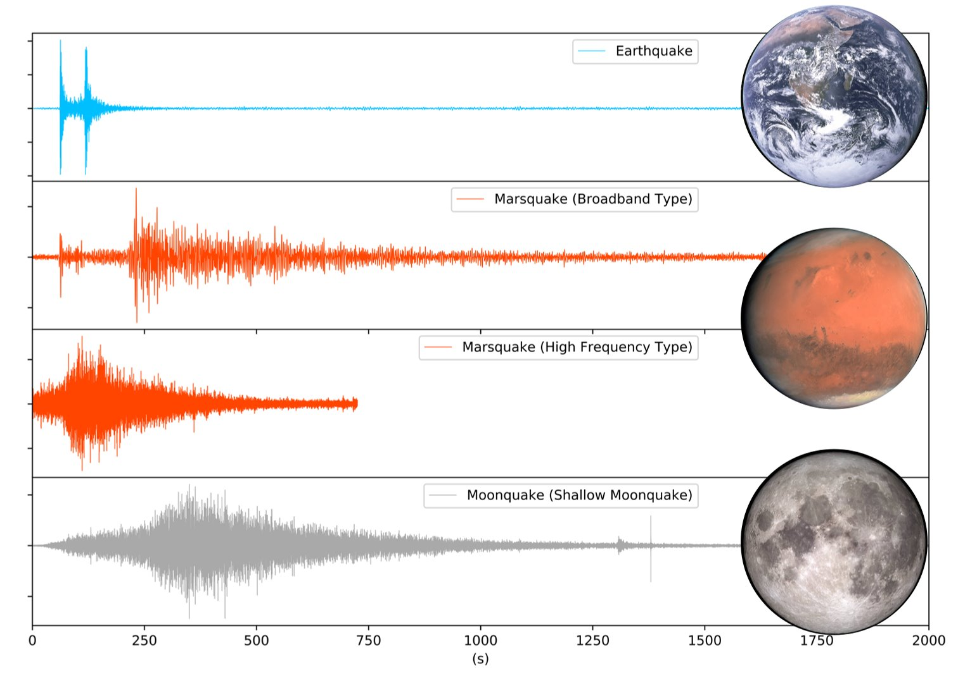
Lunar Seismic Environment
Seismic background from meteoroid impacts, thermal quakes, deep&shallow moonquakes
Minimum on Earth
Upper limit on lunar seismic background
Sensitivity of proposed PSR seismic explorer Soundcheck
Modeled lunar background
T Kawamura

Slide 12
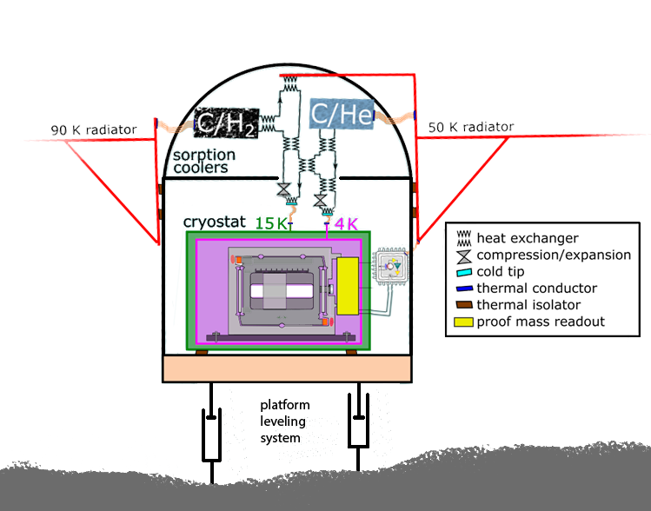
The Payload of the Lunar Gravitational-wave Antenna
(J Appl Phys 131, 244501, https://doi.org/10.1063/5.0144687)
1. Inertial sensor
2
2. Sorption cooling and thermal management
1
3. Seismometer leveling system
3
van Heijningen et al, 2023

Slide 13
Soundcheck: ESA Selection
LGWA proposal for LGWA pathfinder mission/payload Soundcheck was submitted in September 2022
ESA selected Soundcheck into the «Reserve Pool of Science Activities for the Moon» waiting for a flight opportunity
The selection activates the ASI commitment given in their endorsement letter to consider the full or partial support for the activities
ESA requests the submission of an Activity Requirements Document early November 2023
The payload team identified technology gaps, and we will request funding from national space agencies to close the gaps

Slide 14
Soundcheck vs LGWA
 | Soundcheck (PSR geophysical explorer) | LGWA (GW observatory)
Number of seismic stations | 1 seismic station (two horizontal channels) with sensors on lander | 4 seismic stations (each with two horizontal channels) deployed on ground and forming a kilometer-scale array
Displacement sensitivity | <1pm/Hz^{1/2} between 0.1-1Hz | <1pm/Hz^{1/2} at 0.1Hz, <fm/Hz^{1/2} at 1Hz
Deployment site | Inside any PSR (<100K) | Inside PSR with T<40K
Proof-mass material | Niobium | Niobium or silicon
Proof-mass temperature | Ambient PSR temperature (<100K) | Cooled to 4K with low-vibration cryocooler
Readout | Laser interferometric | Laser interferometric or through superconducting coils and SQUIDs

Slide 15
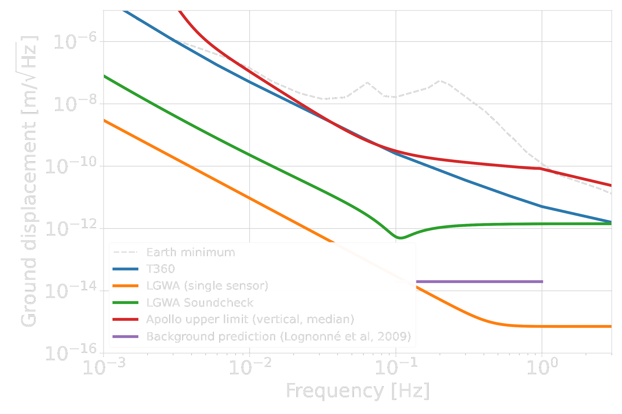
Displacement Sensitivity

Slide 16
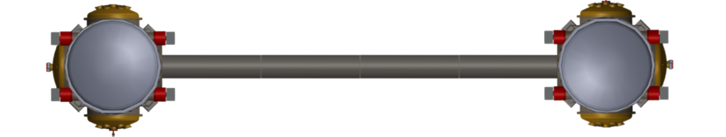
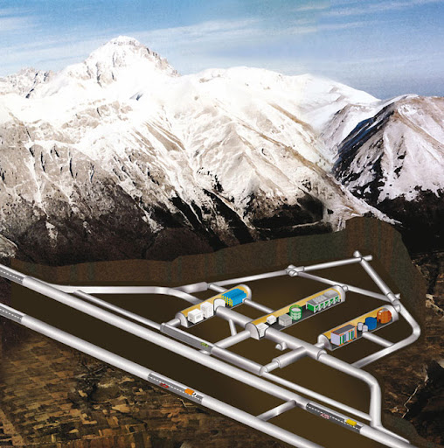
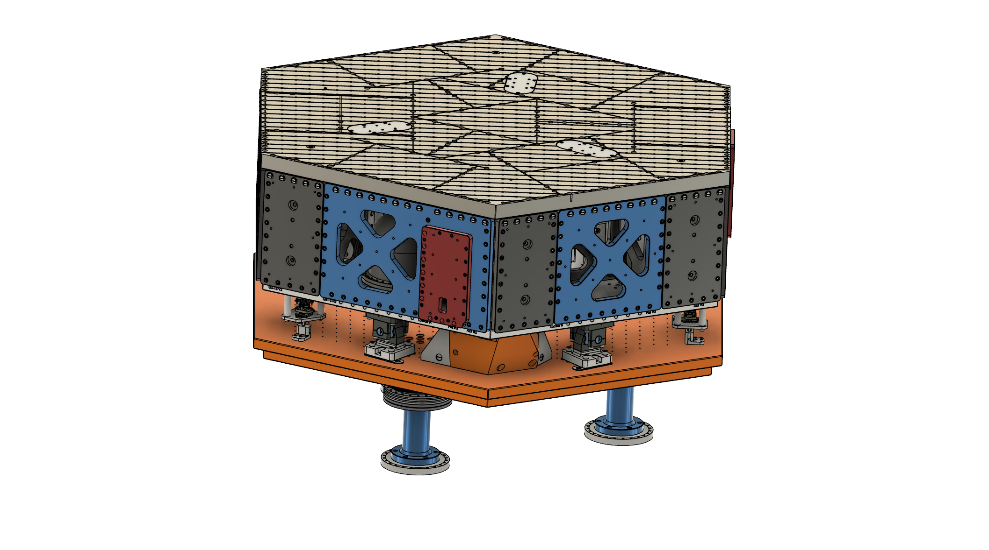
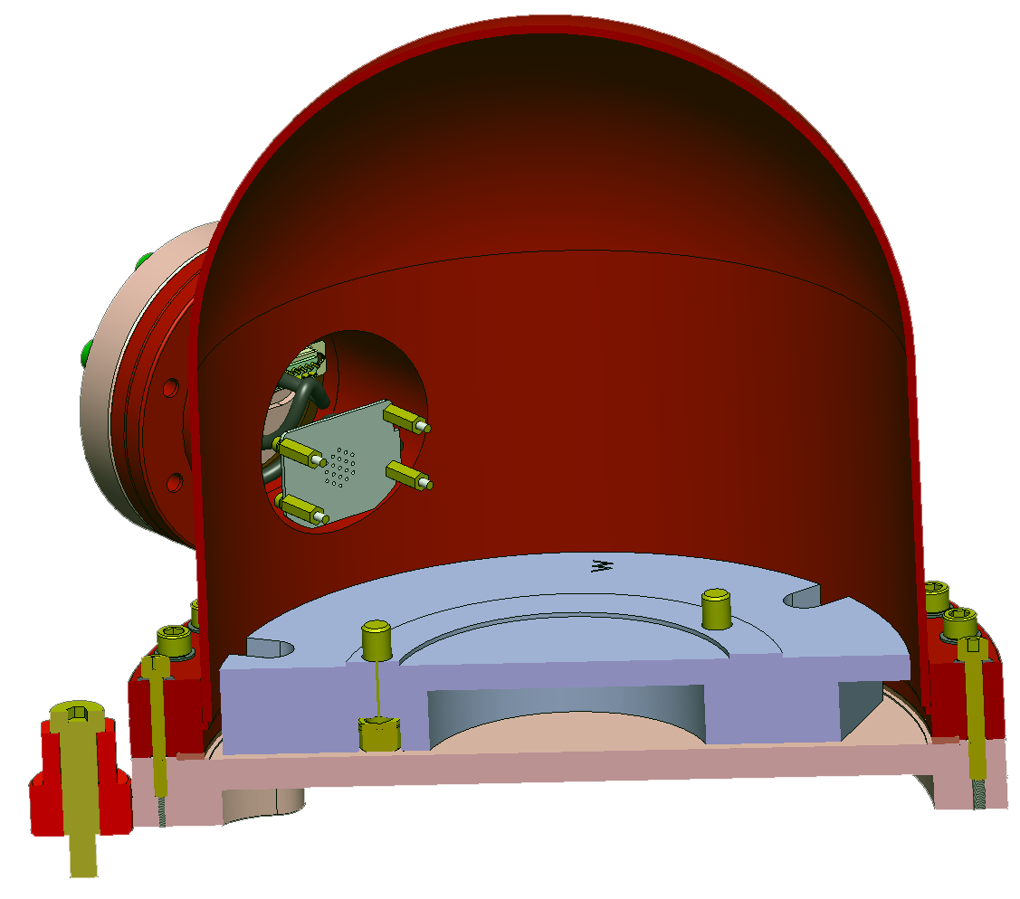
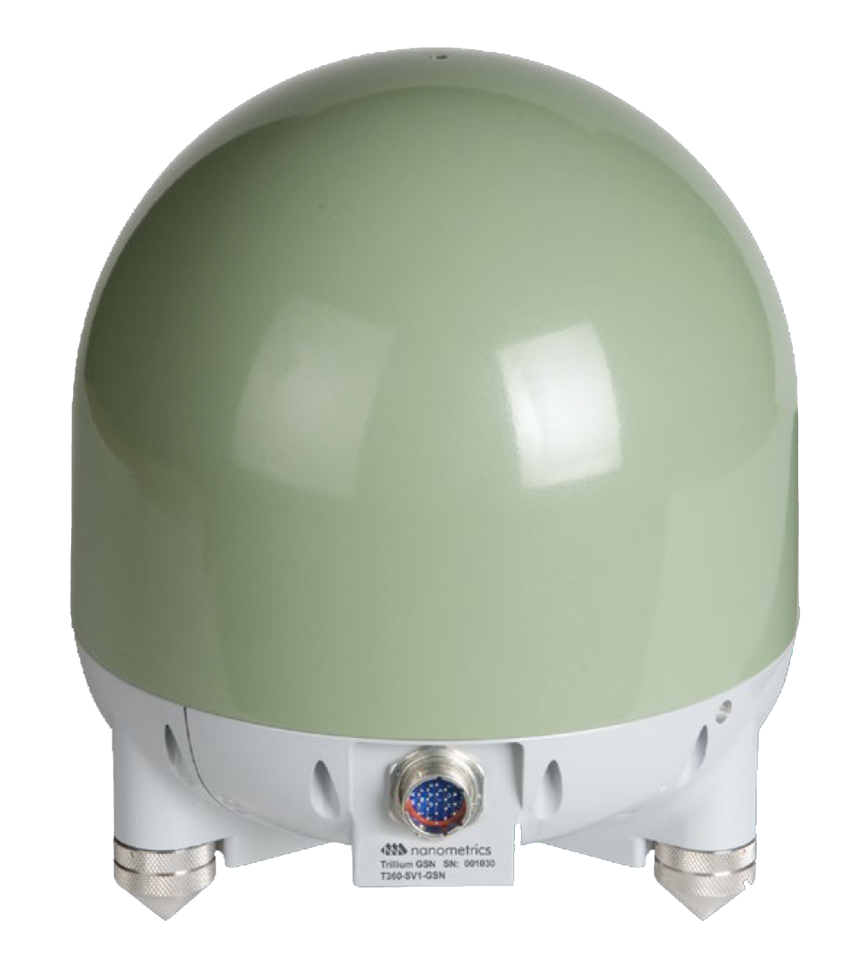
Lunar Emulator
PNRR – ETIC / Vitality-Astra
For LGWA payload testing, ultra-quiet seismic environment is required: underground inertial platform
GEMINI facility
INFN LNGS near L’Aquila
High-end inertial sensors for platform stabilization
A platform like the Moon

Slide 17
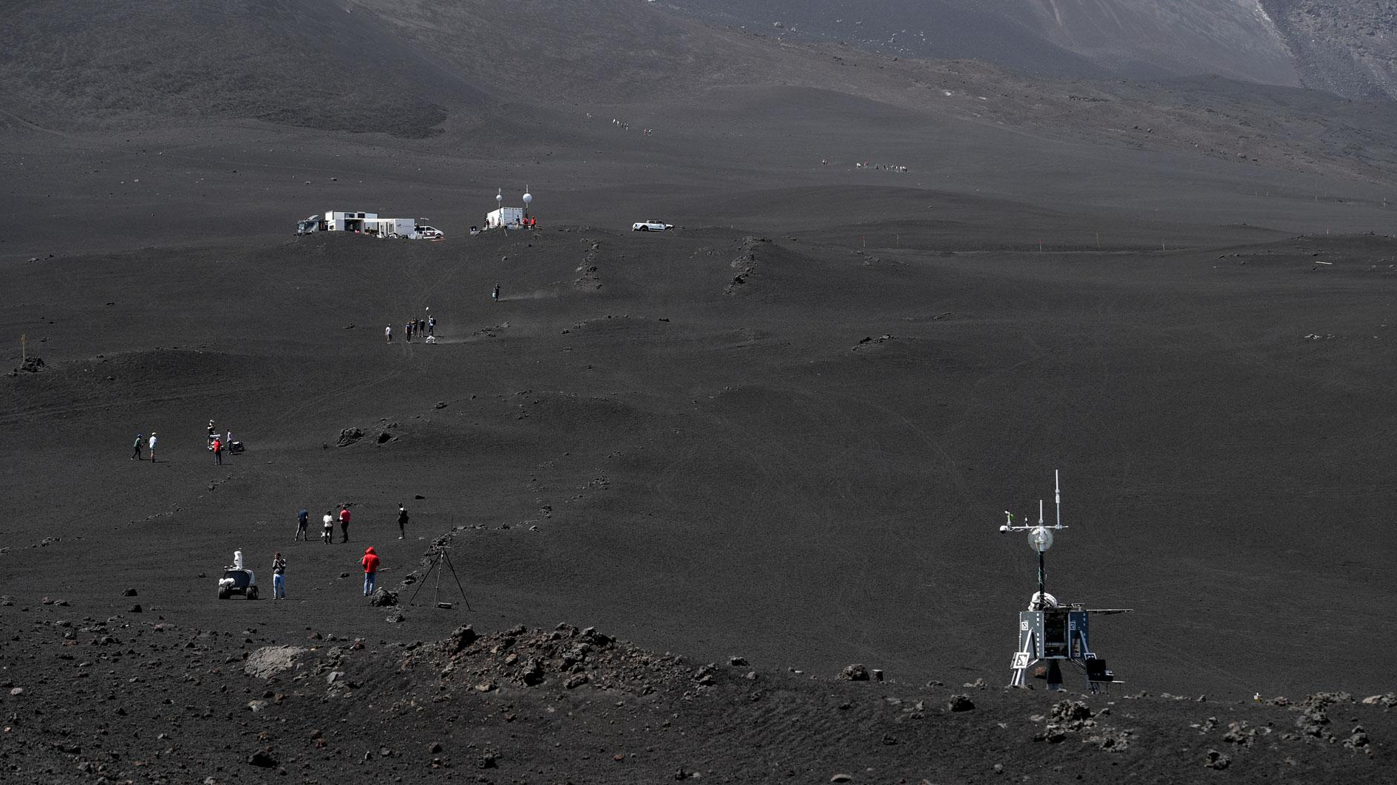
Mt Etna as Lunar Analog
Credit: DLR

Slide 18
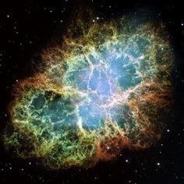
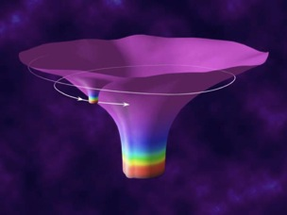
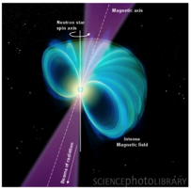
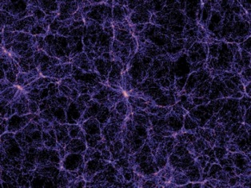
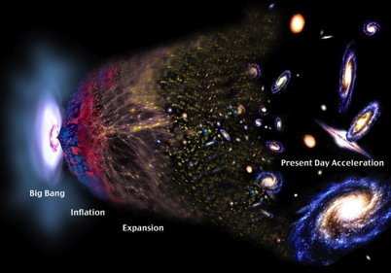
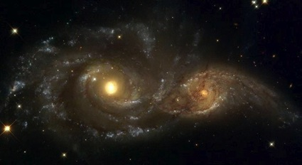
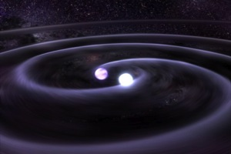
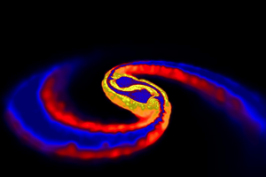
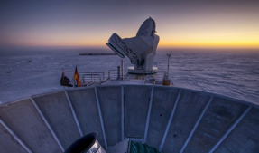
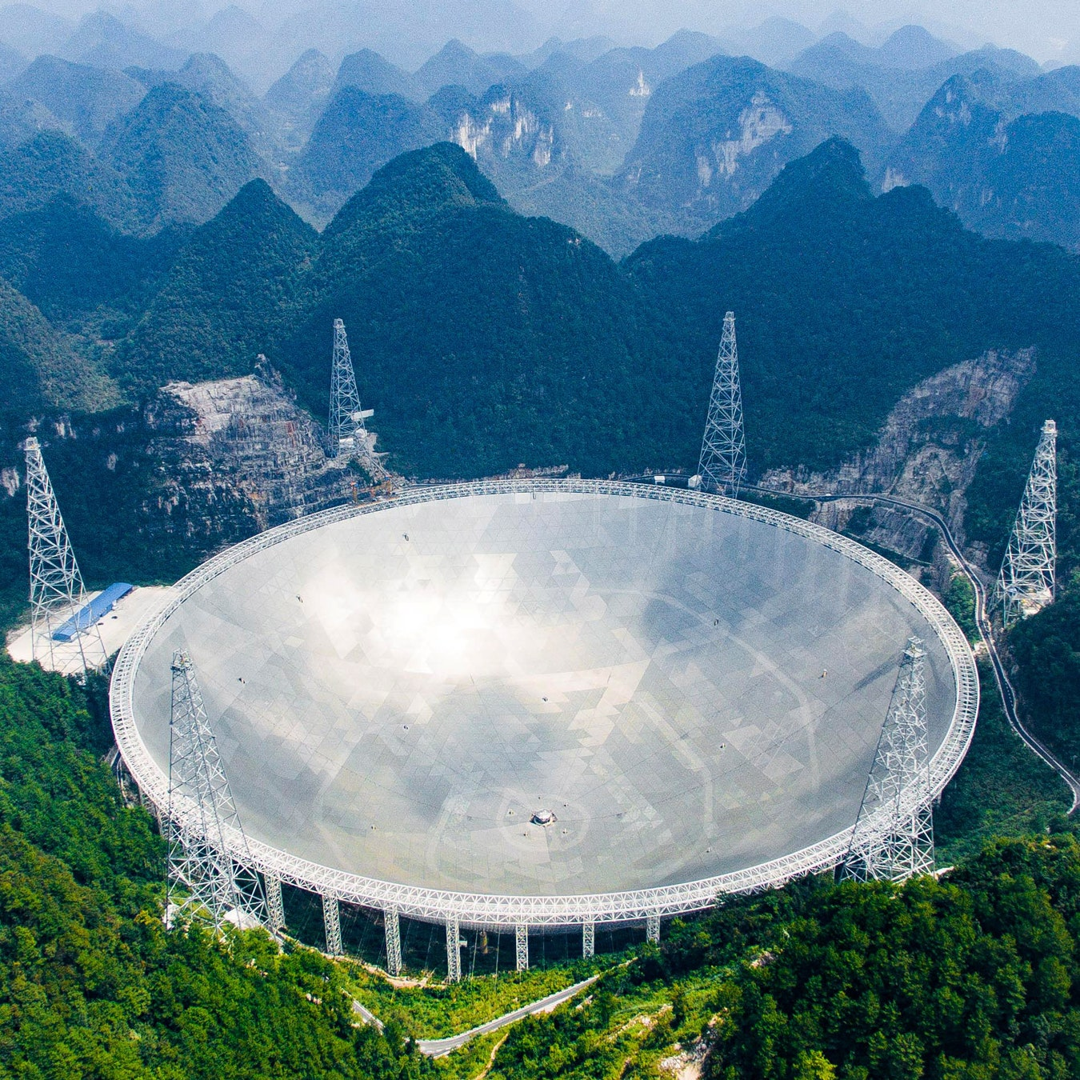

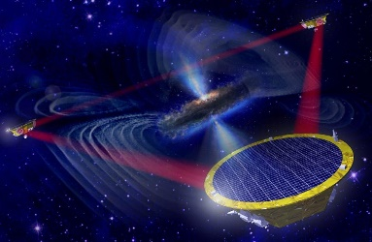
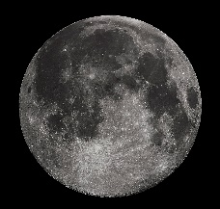
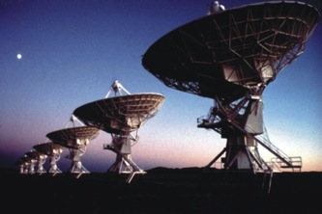
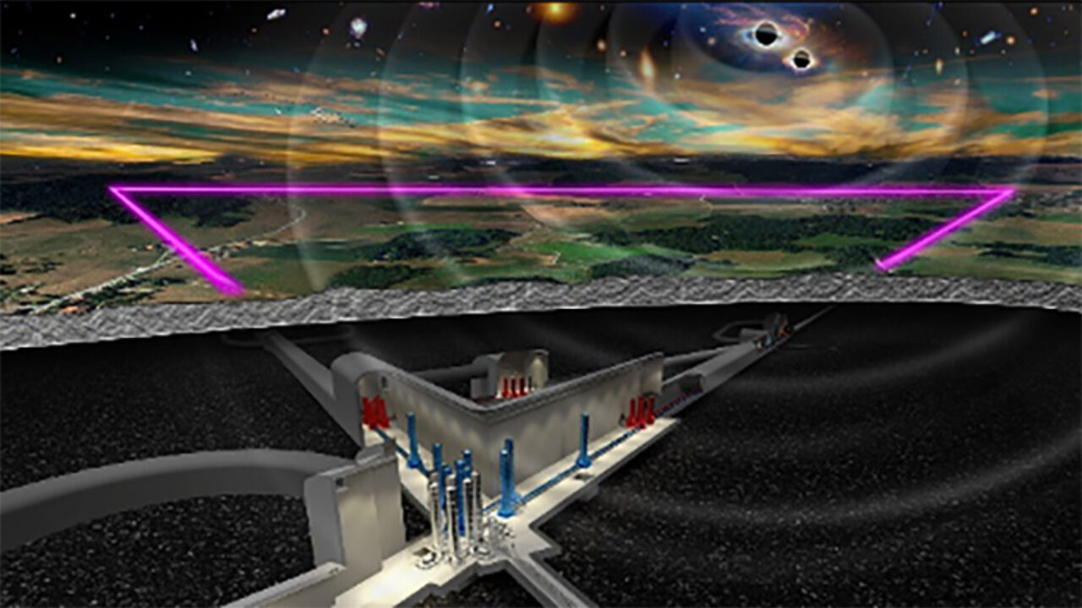
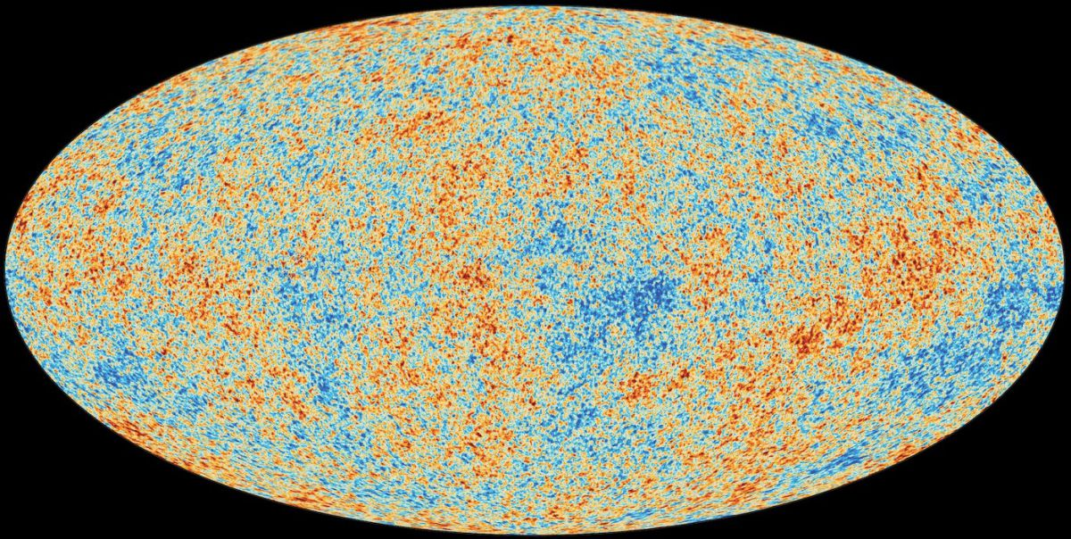
GW Observations
Extreme mass-ratio inspiral
Supernovae
Cosmic strings
Background radiation
Spinning NS
Supermassive BH
binaries
Massive and
intermediate mass BBH
Solar-mass binaries
10⁻¹⁶ Hz
10⁻⁹ Hz
10⁻⁴ Hz
10⁰ Hz
10³ Hz
Microwave background
Pulsar timing
Space detectors
Terrestrial
Missing link

Slide 19
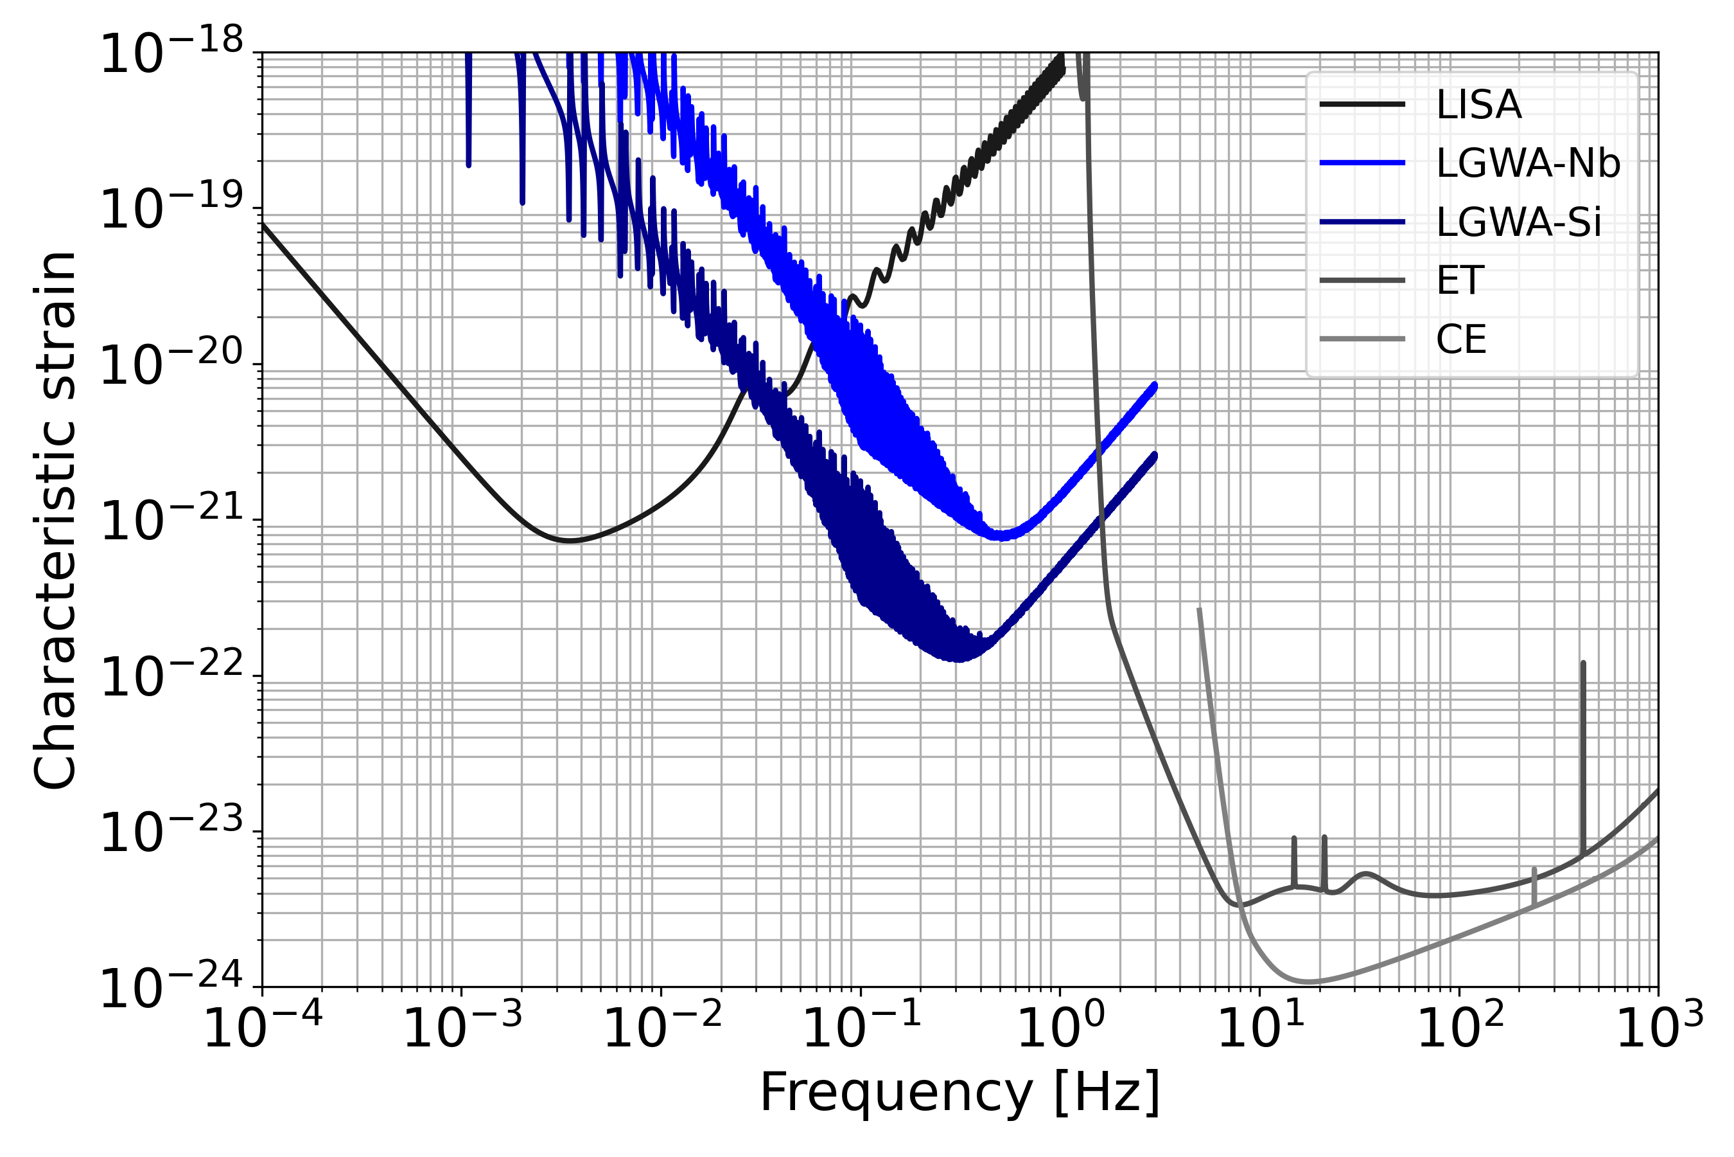
The Missing Link
Solar-mass BBH
(Super)massive
BBH
Intermediate-
mass BBH

Slide 20
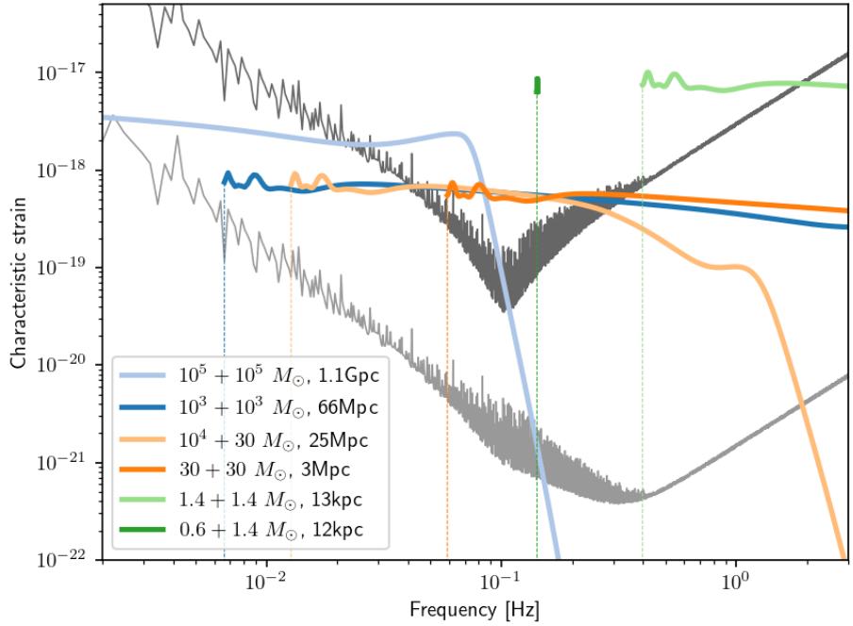
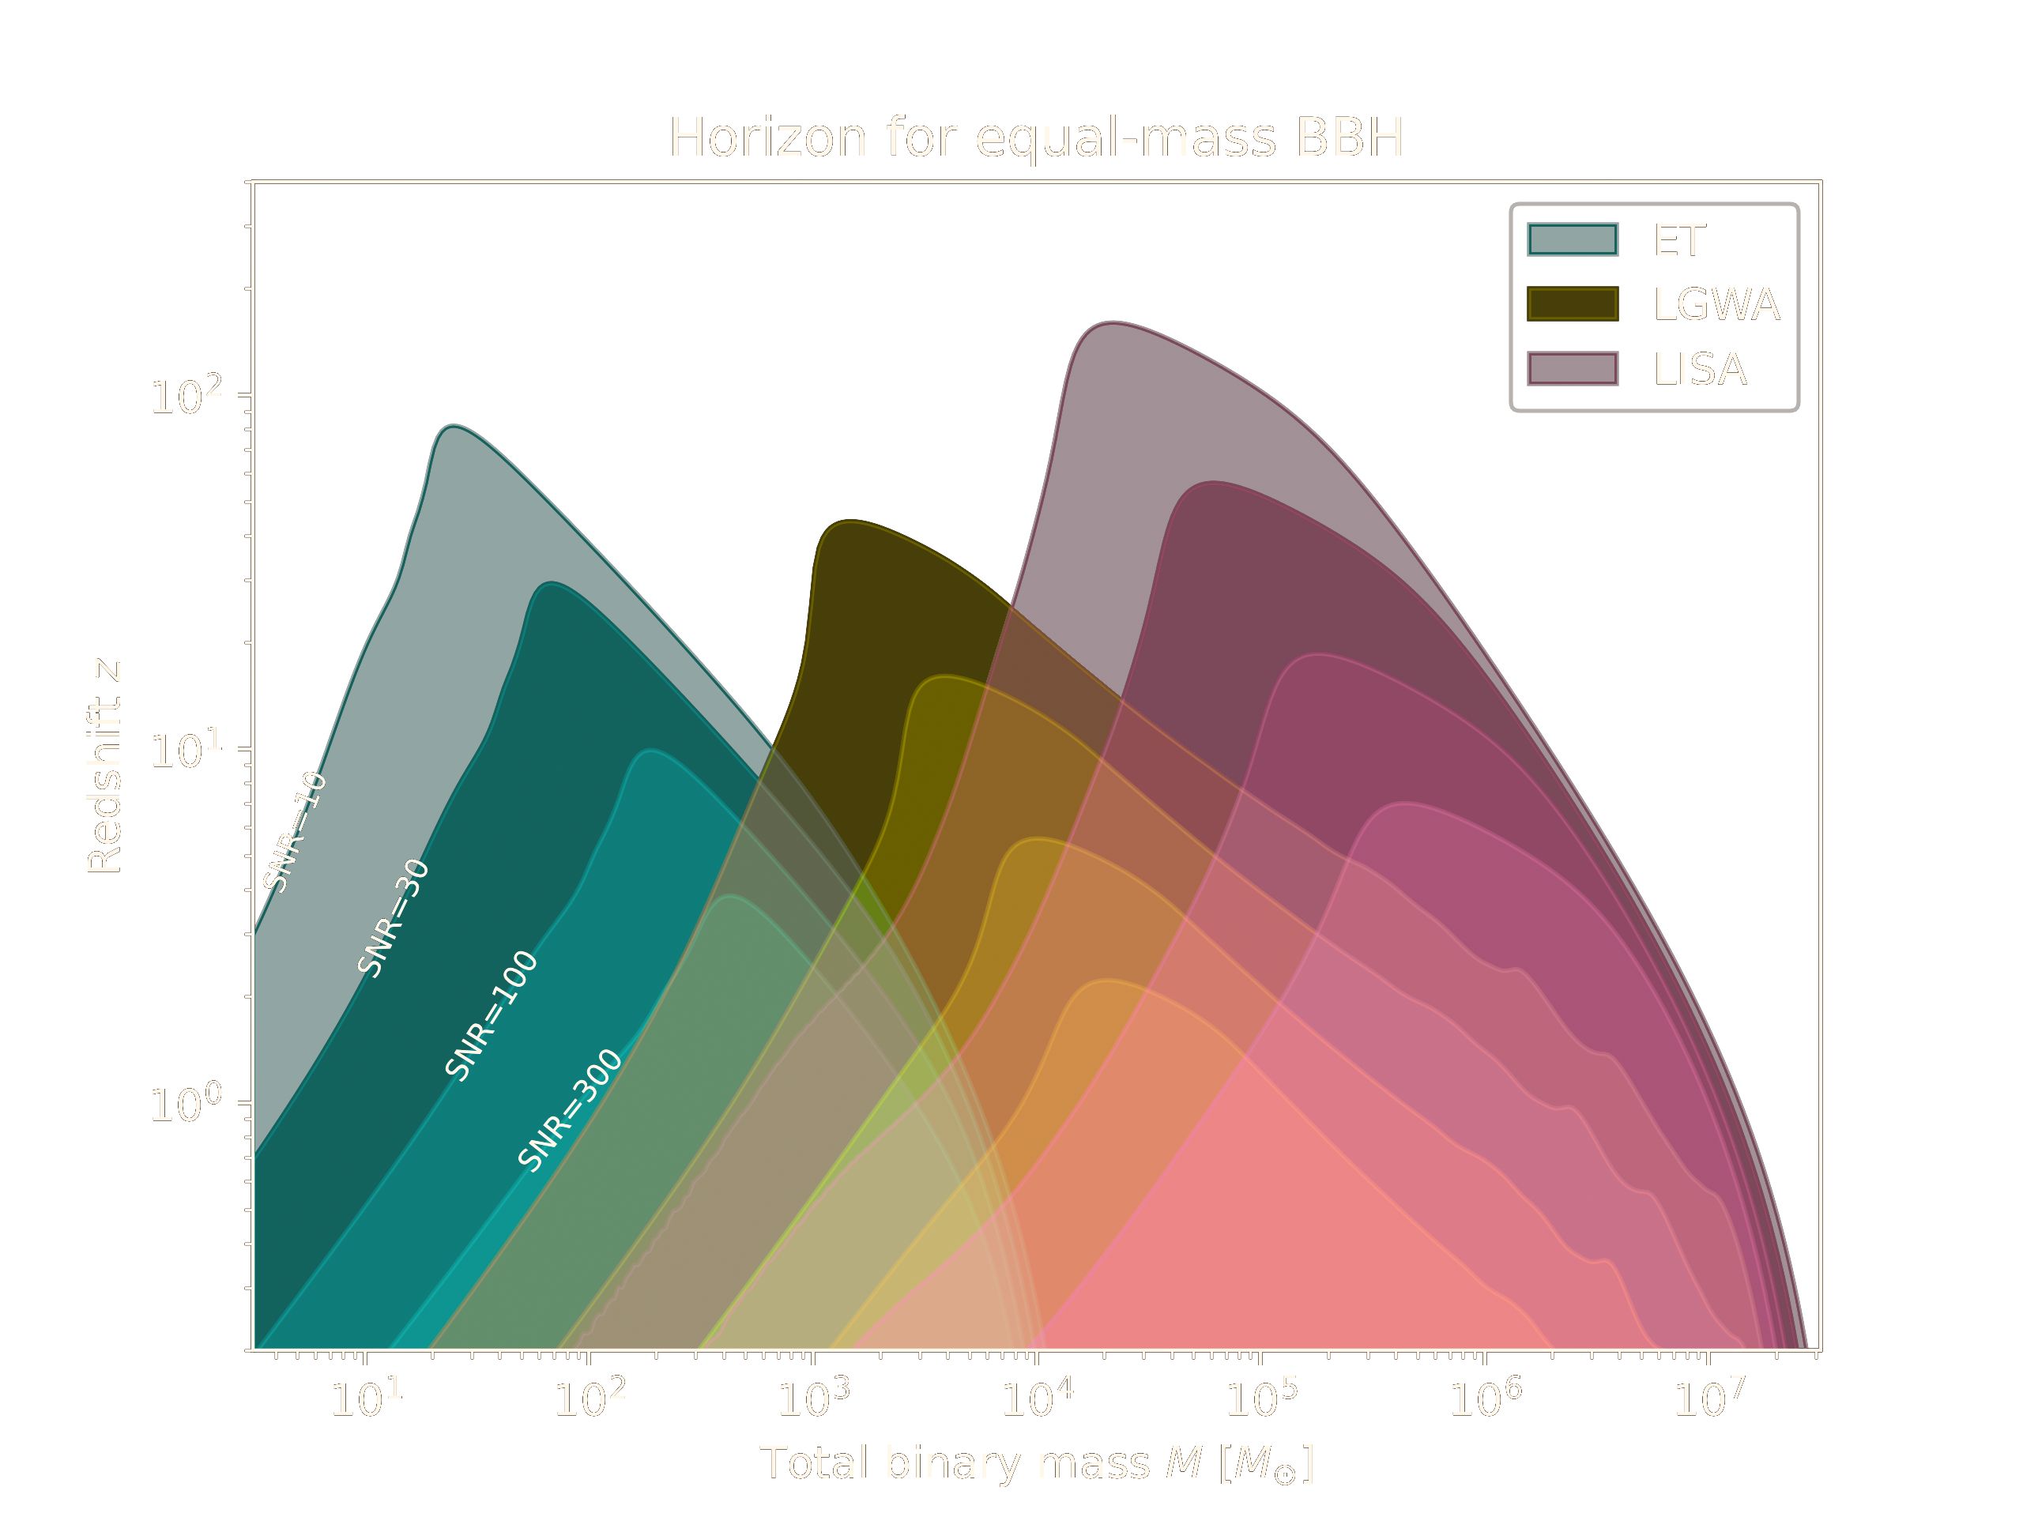
Sensitivity Targets
Lunar orbital modulation of GW phase leads to <1deg² sky localization.
Moon’s rotation
Soundcheck
LGWA
https://github.com/janosch314/GWFish

Slide 21
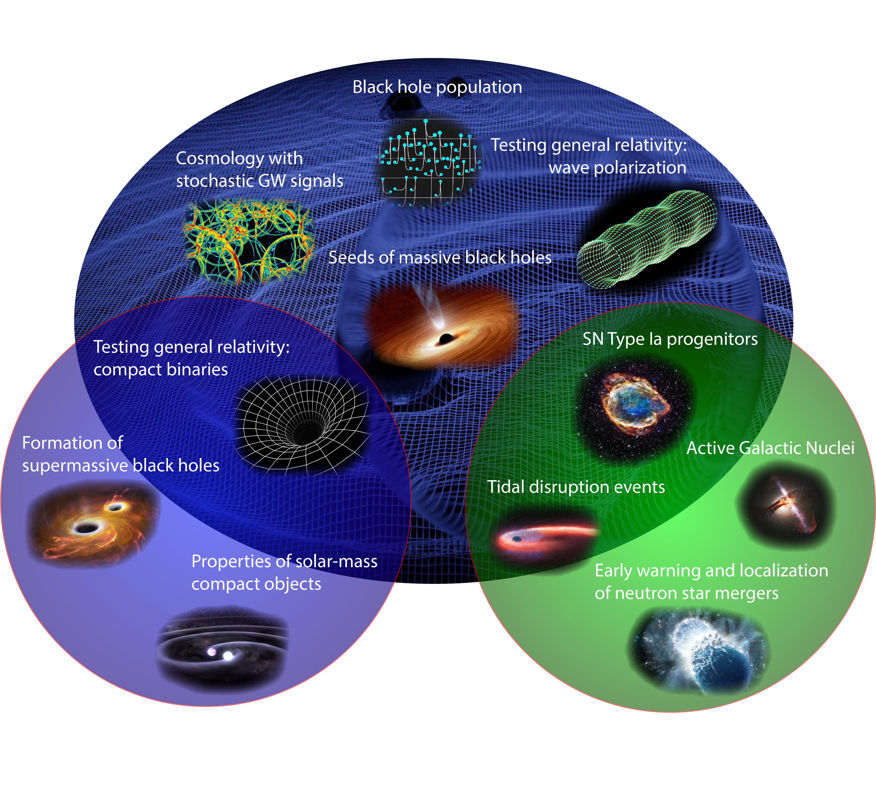
LGWA GW Science

Slide 22
LGWA Science White Paper
2 The Lunar Gravitational-wave Antenna
2.1 Mission concept
2.2 Sensitivity model
2.2.1 Payload descriptions
2.2.2 Main noise contributions
2.2.3 Reduction of the seismic background
2.2.4 Lunar response to GWs
2.2.5 Sensitivity models of LGWA and Soundcheck
2.3 Observational capabilities
2.3.1 Detection horizons
2.3.2 Detection rates
2.3.3 Sky localization
2.3.4 Merger-time predictions
2.3.5 Multiband GW observations
2.4 Science of the Moon and the deployment site
2.4.1 Topography
2.4.2 Geological model
2.4.3 Solar illumination and surface temperature
2.4.4 Regolith composition
2.4.5 Ground tilt response
2.4.6 Seismic background
2.4.7 Magnetic fluctuations on the lunar surface
2.5 Lunar missions and data relevant to LGWA
2.6 Science requirements
2.6.1 Gravitational-wave science
2.6.2 Lunar science
3 Science Objectives
3.1 Lunar science
3.1.1 Seismic sources
3.1.2 Lunar internal structure
3.1.3 Moon’s formation history
3.1.4 Geologic processes
3.2 Gravitational-wave science.
3.2.1 Populations and formation channels of GW sources.
3.2.2 GW astrophysics
3.2.3 GW cosmology
3.2.4 Fundamental physics with GWs
3.3 Multi-messenger Observations
3.3.1 Compact Binaries with Neutron Stars and White Dwarfs
3.3.2 Tidal Disruption Events
3.3.3 Intermediate and Massive Black Hole Binaries
3.3.4 Extreme/intermediate Mass-ratio inspirals
3.3.5 Supernovae
3.4 Synergies with Other Missions and Terrestrial Observatories
3.5 Other Science
Goal: First complete and internally reviewed draft by the end of 2023
Content: Research to prepare for LGWA, science with LGWA data, relations/synergies with other observatories and lunar missions

Slide 23
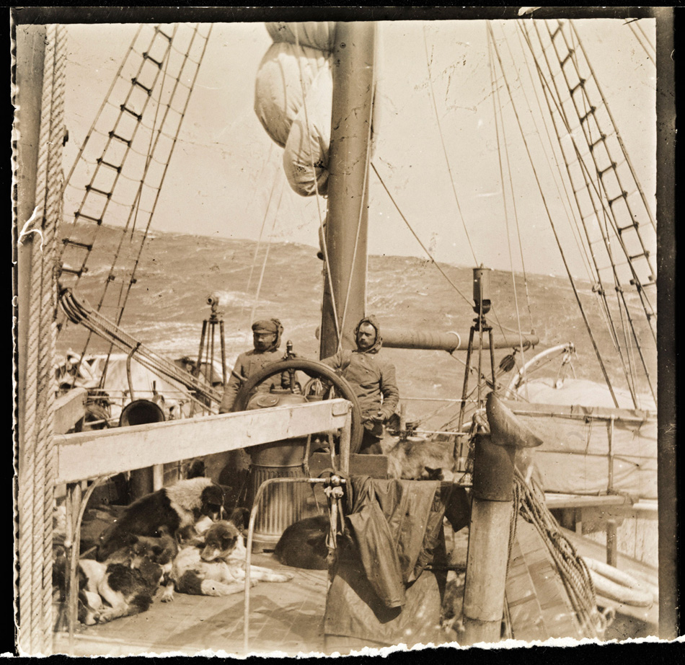
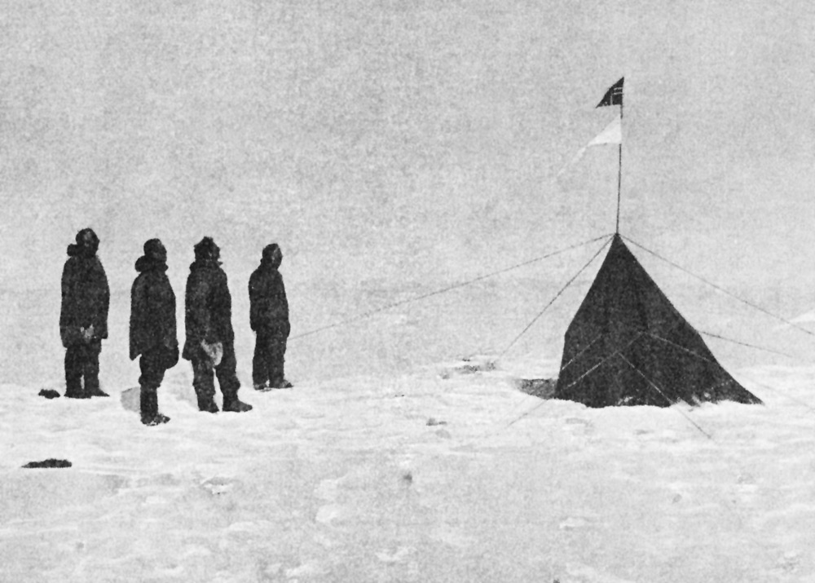
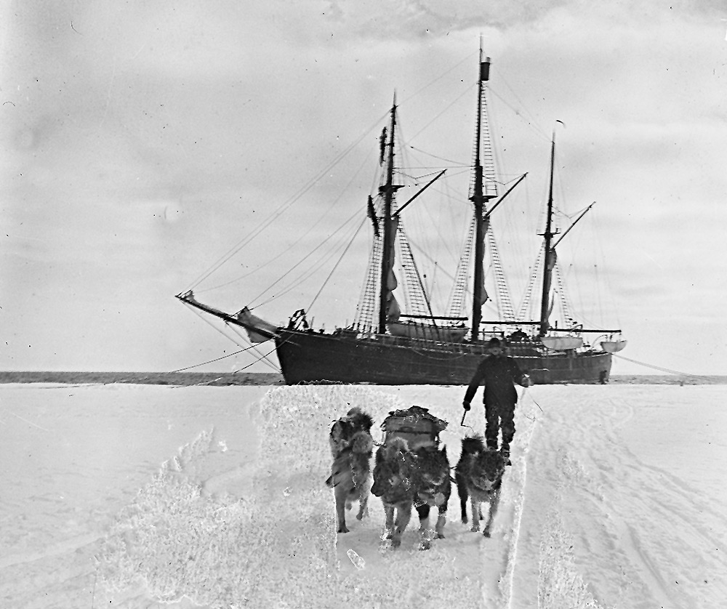
South Pole Expedition
14/12/1911
Roald Amundsen
Helmer Hanssen
Sverre Hassel
Oscar Wisting
Olav Bjaaland

Slide 24
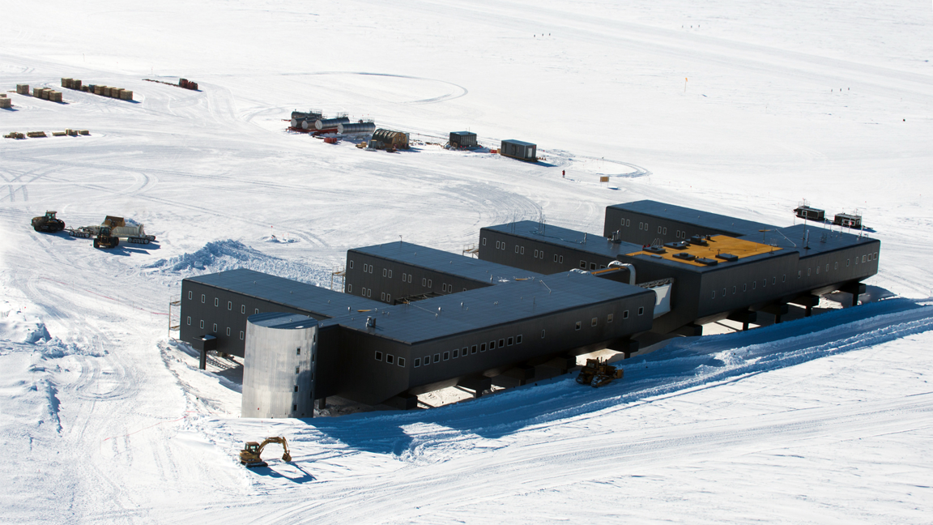
Amundsen-Scott
South Pole Station

Slide 25
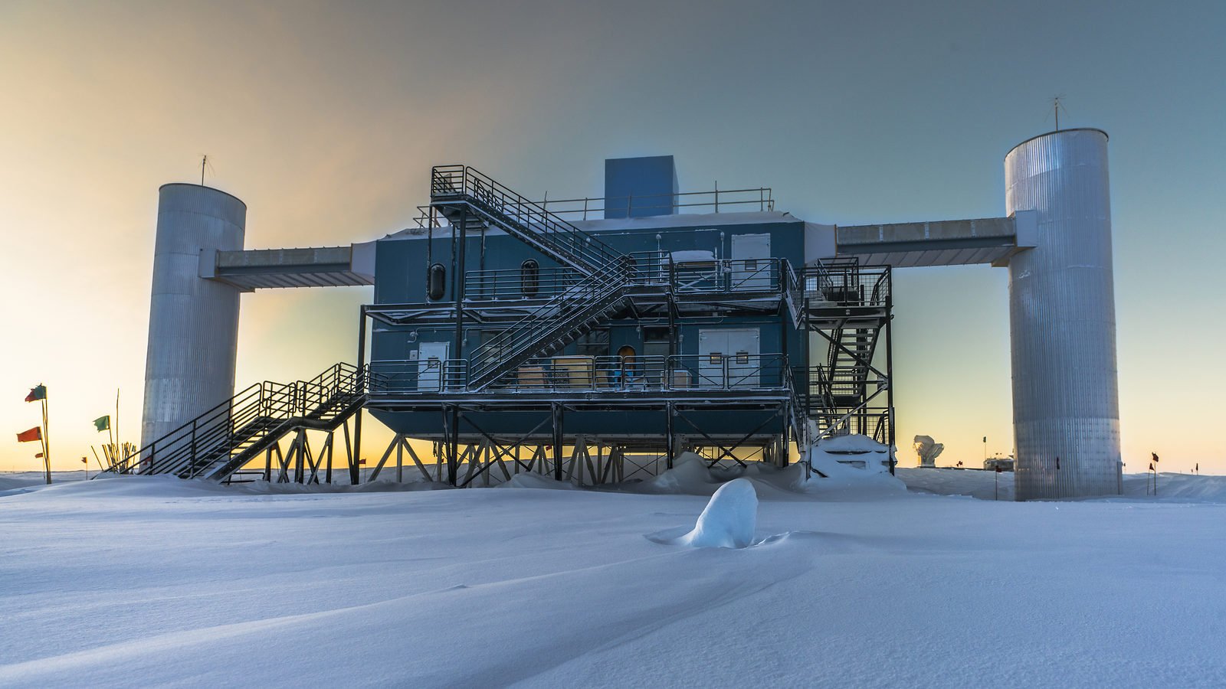
IceCube Neutrino Observatory

Slide 26
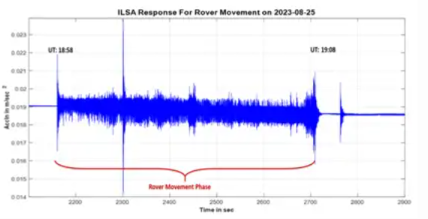
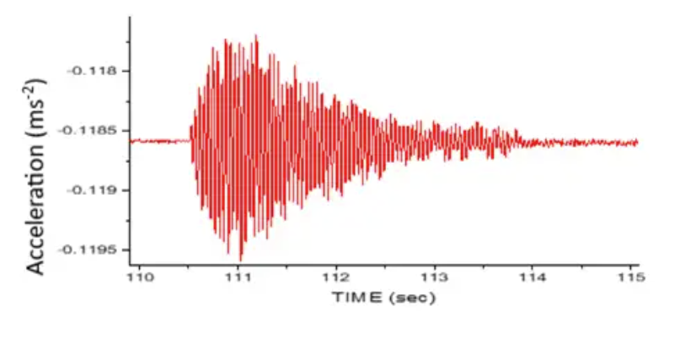
Chandrayaan-3!
Mission is a great success.
ILSA observed ground acceleration.
Chandrayaan-3 is a complex mission. Deployment location is the lunar south-pole region. The total mission cost is <70M€.

Slide 27
Jack Burns et al., 1986:
“The Moon is very possibly the best location within the inner solar system from which to perform frontline astronomical research"

